Slide 1
Spirituality and Osteopathic Medicine
November 11th, 2022
Bob Foster, D.O.

Slide 2
Objectives
Define spirituality in the context of healthcare.
Recognize some spiritual issues in medicine.
Appreciate theory and evidence behind addressing spirituality issues in medicine.
Have some concept of the application of this understanding in patients that present with some apparent spiritual dys-ease.

Slide 3
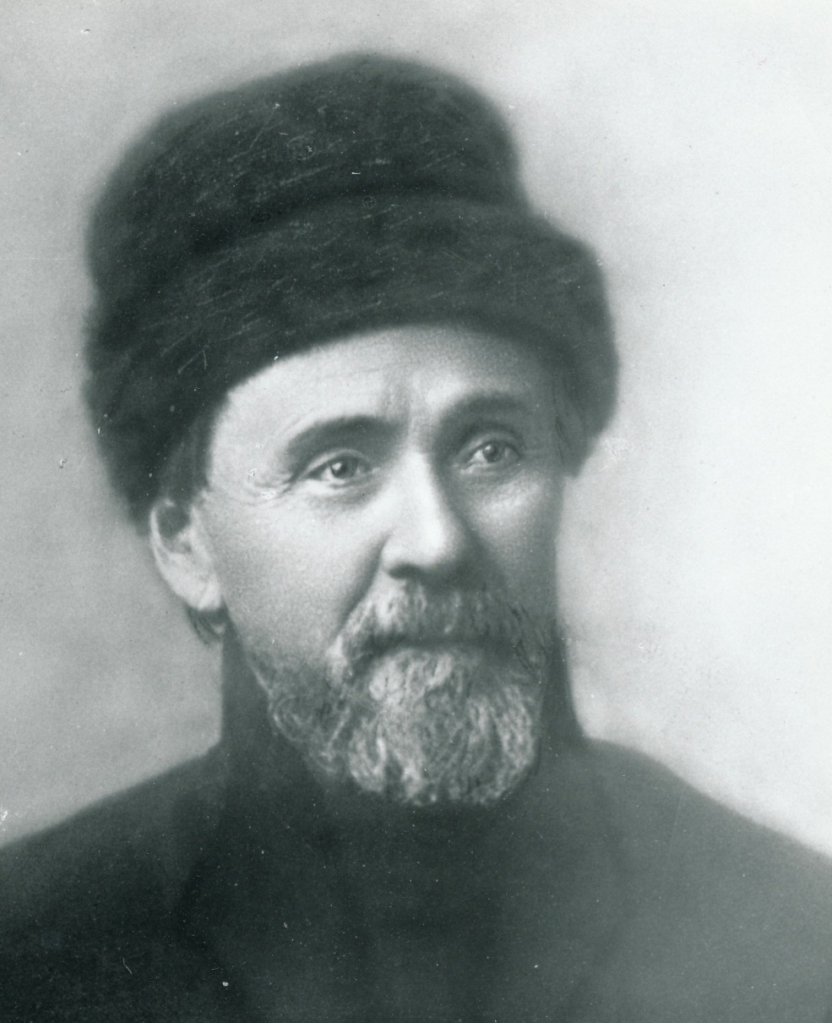
Above all, osteopathy is a PHILOSOPHY

Slide 4
“ All His [God’s] works, spiritual and material, are harmonious. His laws of animal life was absolute. So wise a God had certainly placed the remedy within the material house in which the spirit of life dwells. With this thought I trimmed my sails and launched my craft as an explorer.”
A.T. Still…. Autobiography, p. 99

Slide 5
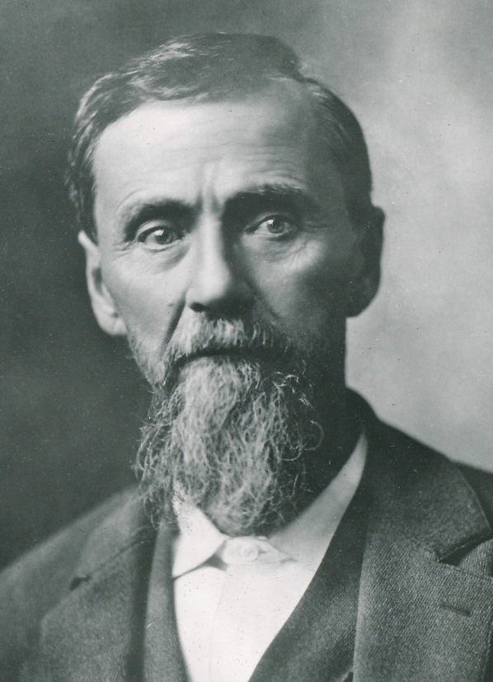
The Principles of Osteopathy:
- Cause and effect
- Nature’s drive to
express health

Slide 6
The Four Principles of Osteopathy as defined in Glossary of Osteopathic Terminology.
The human being is a dynamic unit of body, mind and spirit.
The body is capable of self-regulation, self-healing and health maintenance.
Structure and function are reciprocally interrelated.
4. Rational treatment is based upon these principles.

Slide 7
Spirit Defined:
The force within a person that is believed
to give the body life, energy, and power. - Merriam-Webster Dictionary

Slide 8
Spirituality:
Medical Literature Definitions:
Spirituality has to do with the spirit or soul.
  It gives us our power and energy.
  It motivates us to pursue virtues such as love, truth and wisdom.
It is the ability to find peace and happiness in an imperfect world.
  Dr. Fulford’s Touch of Life by Robert Fulford, D.O.
  Love Medicine and Miracles by Bernie Siegal, M.D.

Slide 9
Spirituality:
Medical Literature Definitions:
It contributes to a person’s sense of wholeness and wellness
It is an internally focused belief and relationship in the creator / higher power / God.
It has to do with our search for the meaning of life.
The sense of spirituality is often central to our personal identity.
It is manifested in the experience of
joy, love, forgiveness, and acceptance.

Slide 10
What is Spirituality?
I llness
Wellness

Slide 11
Meaning and Purpose to Life
What is the effect of illness?
Spiritual crisis
  Meaninglessness / hopelessness.
Heightens awareness of personal limits and unfulfilled purpose.
It may prompt a spiritual journey.

Slide 12

Elements of Spirituality – Connection with others
”We” in wellness
Relationships are fundamental to human experience and contribute to personal resilience.
“I” in illness
May separate/isolate the patient from other people.
    Alienation
    Hopelessness
    Suffering
    Aloneness

Slide 13
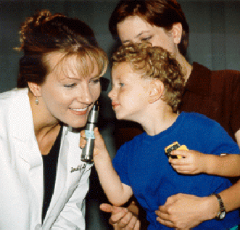
Elements of Spirituality
Connection with others
Doctor-patient relationship
  Sharing in illness experience
  with compassion and caring.
  Contributes to sense of connectedness
  for patient.
  A potentially spiritual encounter with
  great healing potential.

Slide 14
Terminology of Spiritual Energy
Multicultural descriptions of spirituality
  Chi (Chinese medicine)
  Ruach / wind / spirit (Jewish mysticism)
  Vital force (Samuel Hahnemann)
  Life (A.T. Still, M.D., D.O.)
  Breath of Life (W.G. Sutherland, D.O.)

Slide 15
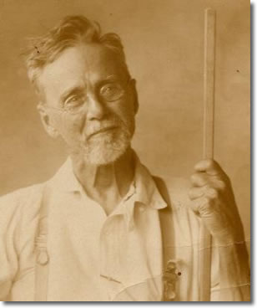
Spirituality In Osteopathic Philosophy
www.atsu.edu/images/ATwStick.jpg

Slide 16
Spirituality In Osteopathic Philosophy
A.T. Still, M.D., D.O.
Dr. Still viewed spirituality not as a hypothetical abstraction but as a harmonious, resonant, inseparable part of body unity.
The spiritual body woven into the mental and physical bodies:
  Not out there somewhere, but intertwined into every cell, every tissue, every organ, every system, every body.

Slide 17
Spirituality In Osteopathic Philosophy
A.T. Still, M.D., D.O.
In motion Dr. Still saw life.
He saw life as the animating principle uniting the material body with spiritual energy.

Slide 18
“Life surely is a very finely prepared substance, which is the all moving force of nature………”
A.T. Still, The Philosophy and Mechanical Principles of Osteopathy, p. 256.

Slide 19
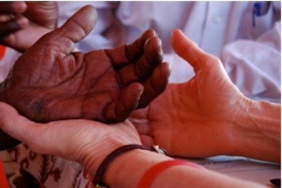
Implications of Dr. Still’s Philosophy for Osteopathic Physicians
When we touch patients, we are touching their spirit as well as their mind and physical body.
The doctor-patient relationship
becomes a sanctuary into
which both participants
voluntarily enter.
That responsibility and honor
must not be taken lightly.
www.pbc.org

Slide 20
Religion
and
Spirituality

Slide 21
What is Religion?
Specific system of belief, worship, conduct, etc.
often involving code of ethics and philosophy. (Theosophy)
Religion is one way of expressing our spirituality.
“Religion is a bridge to the spiritual – but the
spiritual lies beyond religion.” Naomi Remen, MD

Slide 22
Religion and Health
Many of Duke University’s studies of people with strong religious faith have shown:
  Lower diastolic blood pressure
  Lower rates of depression
  Stronger immune systems
  Longevity
  Lower rates of cancer and cardiovascular disease
  Stronger sense of well being
The Healing Power Of Faith, 1999 by Harold Koenig, M.D., Director of
Duke University’s Center For Spirituality, Theology and Health

Slide 23
Religious Involvement, Spirituality and Health Outcomes
Research shows:
  Most people have a spiritual life.
  Most patients want their spiritual needs assessed and addressed.
  Supporting a patient’s spirituality may enhance coping and recovery from illness.
From Mueller, P.S., et.al. Religious Involvement, Spirituality, and Medicine: Implications for Clinical Practice. Mayo Clinic Proceedings. 2001; 76: pp. 1225-1235.

Slide 24
Religious Involvement, Spirituality and Health Outcomes
Research does not show: (MYTH)
  Religious people don’t get sick.
  Illness is due to lack of religious faith.
  Spirituality is the most important health factor.
  Doctors should prescribe religious activities.
From Mueller, P.S., et.al. Religious Involvement, Spirituality, and Medicine: Implications for Clinical Practice. Mayo Clinic Proceedings. 2001; 76: pp. 1225-1235.

Slide 25
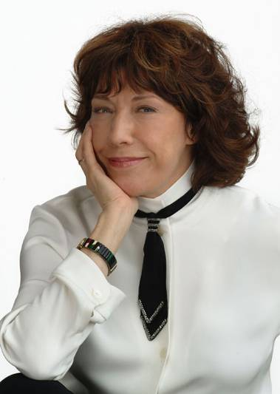
“How come when we talk to God we call it prayer but when God talks to us we call it schizophrenia?”
- Lily Tomlin
kenstein64.files.wordpress.com

Slide 26
Recognizing Spiritual Issues
Patients may express feelings or thoughts that evoke one or more of the following themes:
Unfairness - “Why me?”
Unworthiness – “I don’t want to be a burden.”
Hopelessness – “What’s the point?”
Guilt – “My disease is punishment.”
Isolation, anger – “No one understands me.”
Vulnerability – “I am afraid.”
Abandonment – “God or family doesn’t care about me.”
Confusion - “Why is this happening to me?”

Slide 27
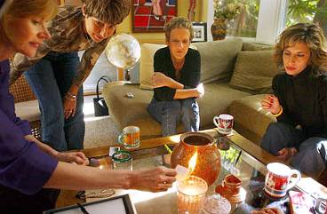
Spiritual Disciplines
Meditation and Imagery
Weekly group therapy sessions including self-hypnotic techniques (i.e. imagery).
Results – Women in group therapy lived twice as long as women not participating in group therapy, and they experienced half the pain, and had less mood disturbances.
  Improved quality of life
  Reduced pain
  Reduced side effects of treatment
Spiegel, D., et al. Effect of psychosocial treatment on survival of women with metastatic breast cancer. Lancet: 1989.
www.sptimes.com

Slide 28
Meeting Our Patient’s Spiritual Needs
Nurture your relationship with your patients.
  Be trustworthy.
  Treat the patient as a person.
  Be kind.
  Maintain hope.
  Listen non-judgmentally.

Slide 29
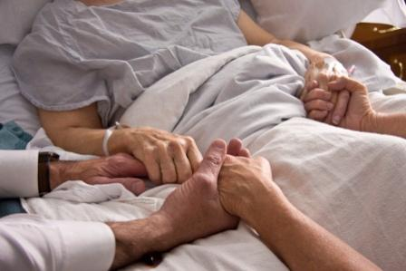
Meeting Our Patient’s Spiritual Needs
It is not necessary for the physician to share the patients religious/spiritual beliefs.
It is important to understand and respect the patient’s belief system.
  Be open to learning from our
  patients and their beliefs.
medscope.blogspot.com

Slide 30
Meeting Our Own Spiritual Needs
  Associate with people of similar spiritual interests and exchange ideas and feelings
  Do something every day that brings you joy.
  Consider keeping a spiritual journal.
  When you find a spiritual path that resonates with you, take it without hesitation.

Slide 31
Evidence of Spiritual Health
Finding the “WE”
Finds meaning and purpose in life events; including illness.
Has hope, faith, and relative absence of guilt.
Able to love and forgive self and others.
Participates in laughter and celebration.
Involved in community of faith and practicing worship, prayer, and/or meditation.
Exhibits feeling of connectedness to everyone and everything.
Expresses empathy towards others.

Slide 32
Forgiveness
Patients with long standing pain often have forgiveness issues they aren’t even aware of.
Just mentioning this possibility sets the mind to working on relationships gone sour. (Anecdotal from medical practice.)
Forgiveness is a teachable skill. (G.A.Pettit, New Zealland Medical Journal, Mar 1987)

Slide 33
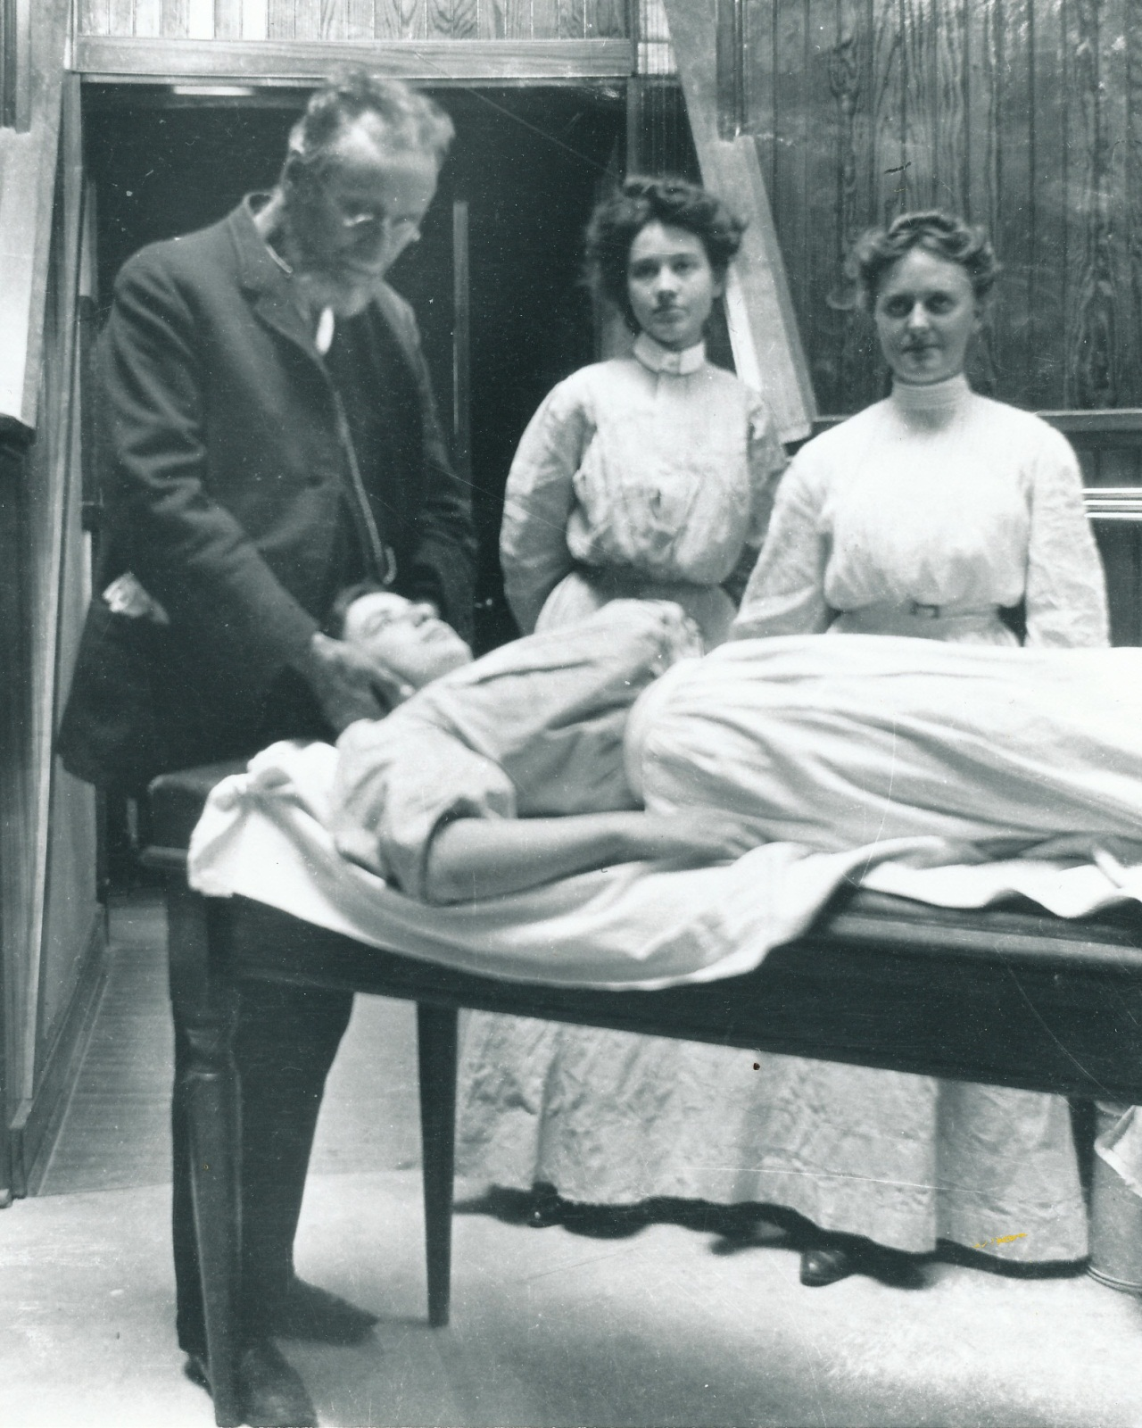
“Do not put your hands on a patient until you first know the anatomy under your fingers, the physiological changes that are taking place, something of the
pathology that may be there, and more than all, that a living soul is within.”

Slide 34
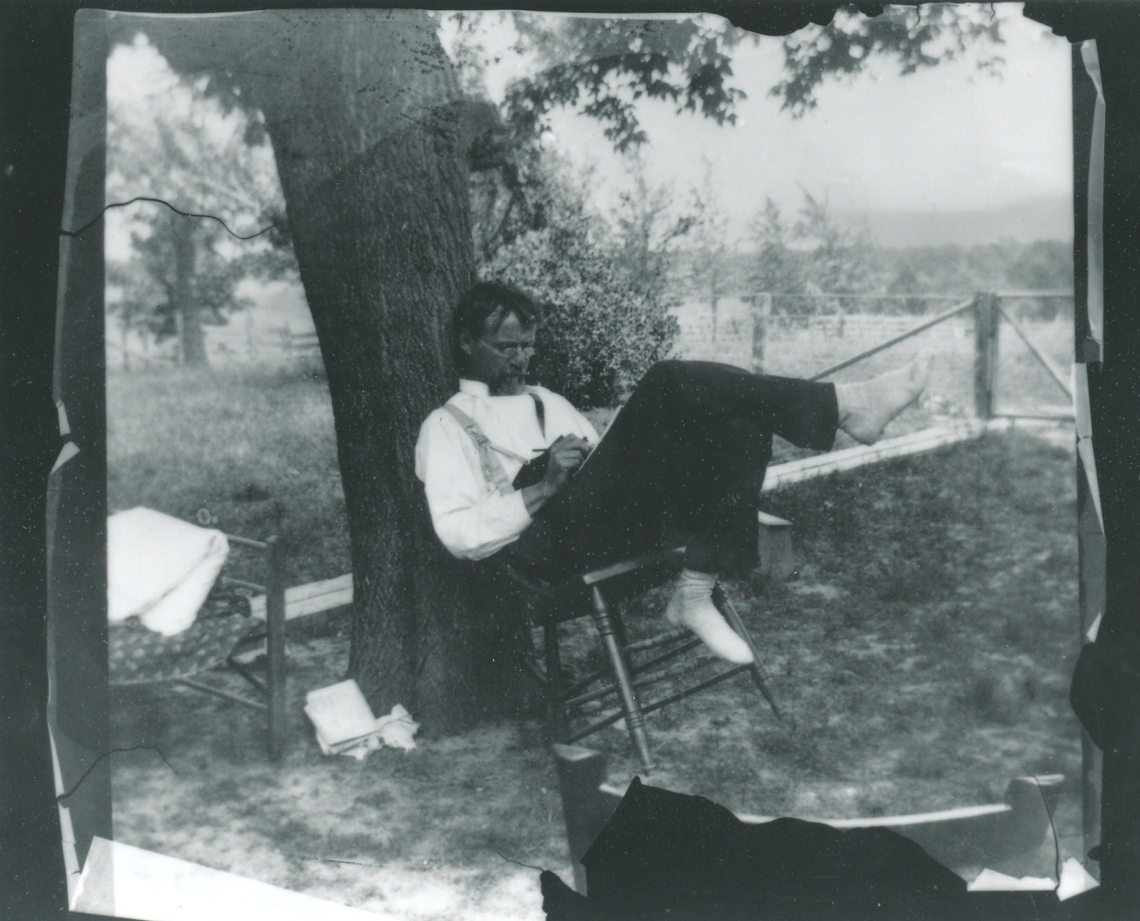
- THE END -

