Slide 1
Epilepsy
Mitzi Payne, MD
Marshall University
Department of Neurology
Pediatric Neurology

Slide 2
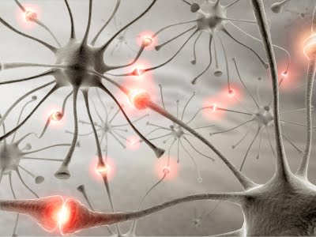
Definitions
Epilepsy
  The tendency to have unprovoked seizures.
Seizure
  “An abnormal movement or behavior that is produced by abnormal excessive neural activity.”

Slide 3
Seizures
“Grand mal” seizure
  Refers to a generalized tonic-clonic seizure.
  Patients do not understand this term and use the term “grand mal” for any “bad” seizure.
“Petit mal” seizure
  Refers to an absence seizure
  Patients do not understand this term and use it to refer to any “small” seizure not to just and absence seizure that would be seen in a patient with primary generalized epilepsy.

Slide 4
Types of Epilepsy
Focal or partial
  Seizures occur as the result of abnormal electrical activity in a specific region of the brain.
  These can then generalize.
Generalized
  Seizures occur as the result of abnormal electrical activity in the entire brain
  Two Types
    Primary Generalized—when there is no structural injury to the brain
    Secondary Generalized---when this is the result of multifocal brain injury

Slide 5
Seizure Types
Generalized Seizures
  Absence
    Manifested by staring and alteration of responsiveness without convulsions.
  Generalized Tonic-Clonic
    Brief tonic movements in all extremities and generalized shaking (clonic movements) follows for a short period of time (typically 30-120 sec), then followed by a period of confusion and lethargy (post-ictal state).
    Most common seizure type.
    Generalized Tonic-Clonic Seizure does NOT mean that the patient has primary generalized epilepsy.
  Myoclonic
    Manifested by brief generalized jerks (myoclonus)

Slide 6
Seizure Types
Focal Seizures
  Focal Motor
    Twitching or shaking in one extremity
    Frontal Origin
  Focal Sensory
    Abnormal sensations in one extremity
    Parietal Origin
  Focal Visual
    Abnormal visual sensations
    Occipital Origin

Slide 7
Seizure Types
Focal Seizures
  “Temporal Lobe” (the most common origin)
    Olfactory Aura
    Gustatory Aura
    Epigastric Distress (most common)
    “Déjà vu”
    Derealization, Depersonalization
    Memory Recall.
    Complex Hallucinations.

Slide 8
Seizure Types
Focal seizures with impairment of consciousness
  May begin in any of the regions discussed above for simple partial seizures. As the seizure activity spreads from the site of origin, the patient may experience altered responsiveness.
  The seizure may then progress to a generalized tonic-clonic seizure.

Slide 9
Seizure Types
Continuous Seizures
  Status Epilepticus
  May be seen with either a focal (partial) or generalized epilepsy.
Reflex Seizures
  Seizures produced by sensory stimulation.
  The photoconvulsive response is the most common of these (accompanied by the photoparoxysmal response on the EEG).

Slide 10
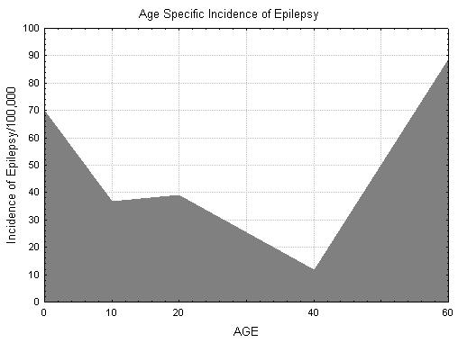
Demographics
Age of Onset
Hauser WA et. al.
Epilepsia 1975 ;16:1-66.
The Incidence of
Epilepsy is Highest in
The Very Young and
The Very Old.
No Large Difference in Incidence Between Males and Females

Slide 11
EEG

Slide 12
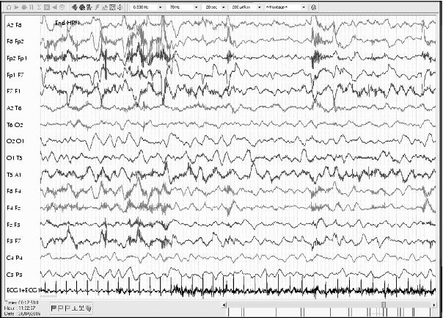
EEG Activating Procedures:
Hyperventilation
Deep and regular respirations at a rate of 20 / minute for 2 to 4 minutes
Drop in plasma CO2 by 4-7 ml%
Normal response (and best seen in children) is high amplitude slow activity

Slide 13
EEG Activating Procedures:
Hyperventilation
Hyperventilation may induce diffuse sharp waves or spike-wave complexes
Patients with generalized epilepsies are most likely to have these findings
Actual seizures can be induced by hyperventilation
  Absence (petit mal)
  Absence (petit mal)
  Absence (petit mal)
  Temporal lobe seizures

Slide 14
EEG Activating Procedures:
Intermittent Photic Stimulation
Strobe light flashes (1-30 Hz)
Photic driving
    Rhythmic activity over the posterior head regions
Photomyoclonic response
    Repetitive muscle spikes over the anterior regions of the head
Photoconvulsive (-paroxysmal) response
    Generalized spike and wave complexes
    15-20 Hz
    May have jerking or impairment of consciousness
    Photosensitive epilepsies

Slide 15
Generalized Seizure Type

Slide 16
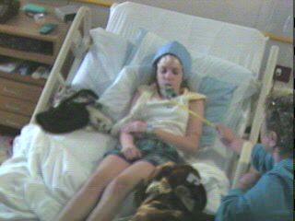
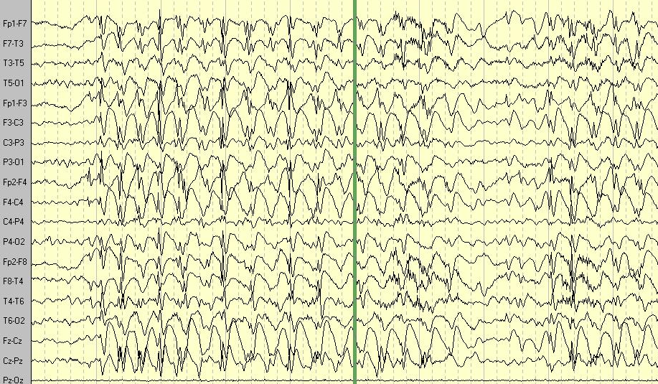
3 Hz spike and wave activity during HV

Slide 17
Childhood absence
(petit mal) epilepsy
Peak onset age 4-6 years
Many seizures daily
Seizures last seconds
70+% have associated automatisms
  eyelid flutter
  simple vocalizations
  picking movements
Typical EEG with 3 Hz spike wave
Majority resolve by adolescence

Slide 18
Treating absence seizures
Ethosuximide
Valproic Acid
Lamotrigine
Beware of carbamazepine

Slide 19
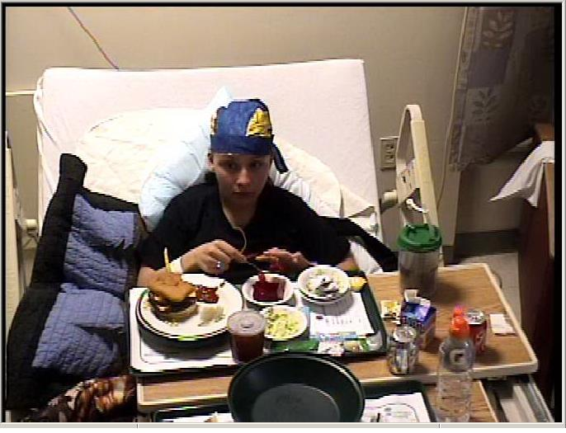
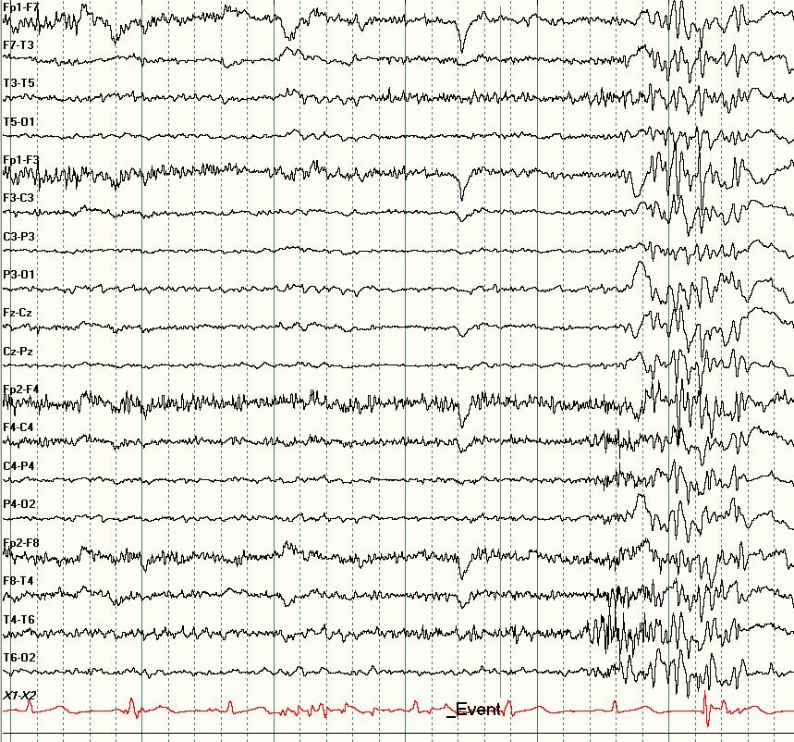
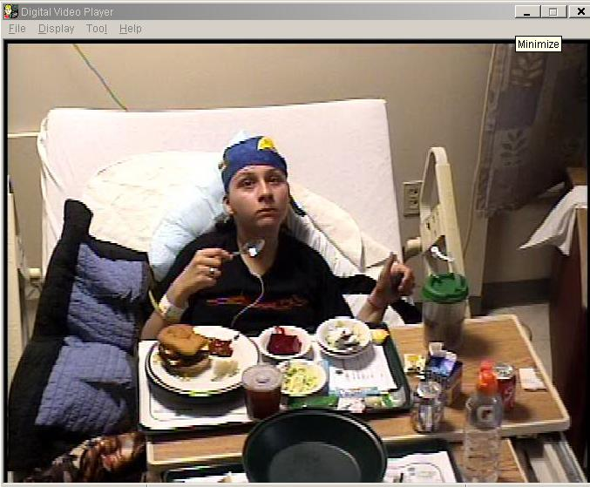
Primary Generalized Epilepsy

Slide 20
Treatment
Medications more limited
Subclinical/ brief seizures (only seen with EEG recording) may complicate management

Slide 21
Focal Seizures

Slide 22
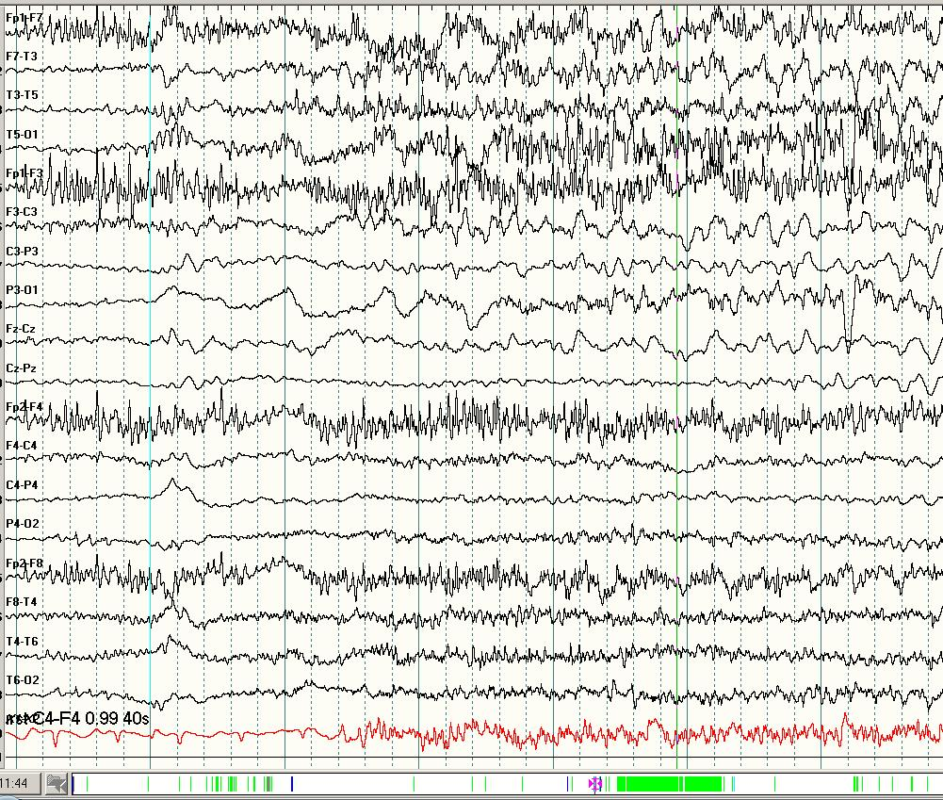
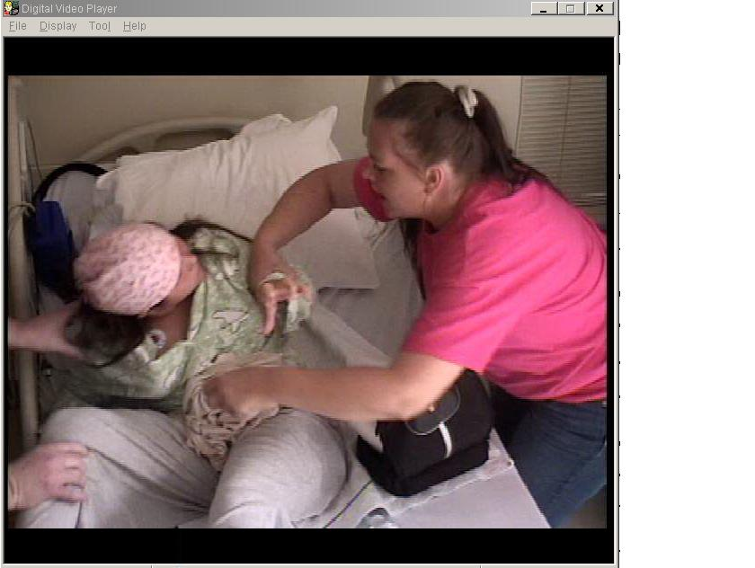
Temporal lobe seizure

Slide 23
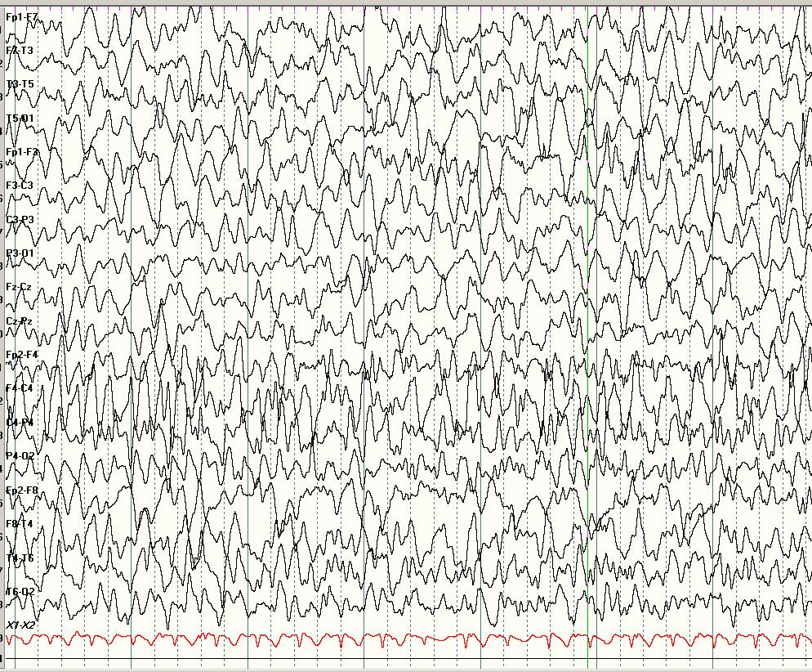
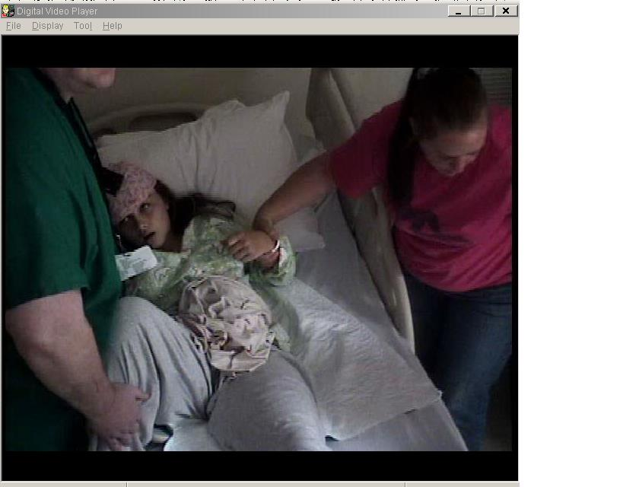

Slide 24
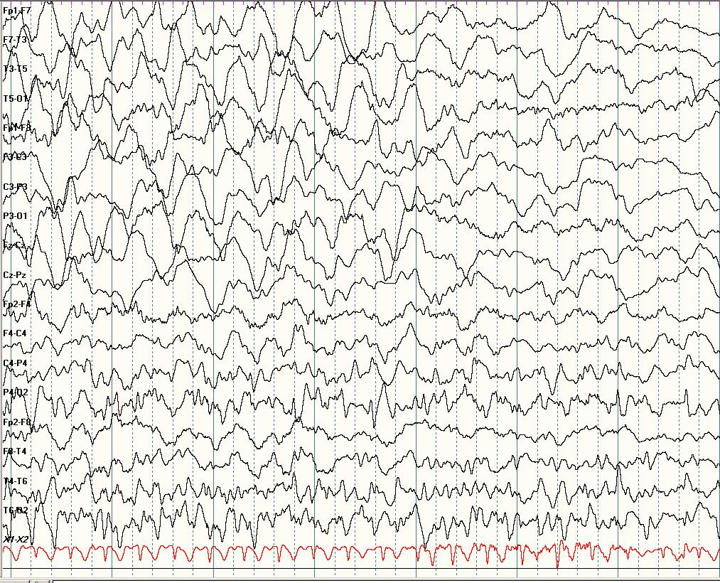
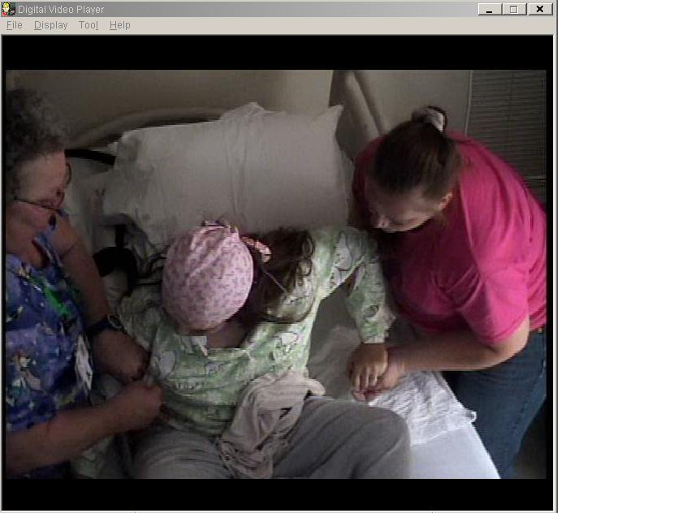

Slide 25
Rolandic epilepsy
Onset ages 2-12 yrs, peak 5-10 yrs
Characteristic seizures
Infrequent simple partial seizures
  tingling in mouth, on face, speech arrest
  rare GTCS in sleep
Resolve by puberty
Characteristic EEG
  high voltage centrotemporal spikes
  usually bilateral
Imaging normal
Considered an idiopathic focal epilepsy
  some evidence for genetic basis
Treatment
  may not be necessary
  may respond to many drugs

Slide 26
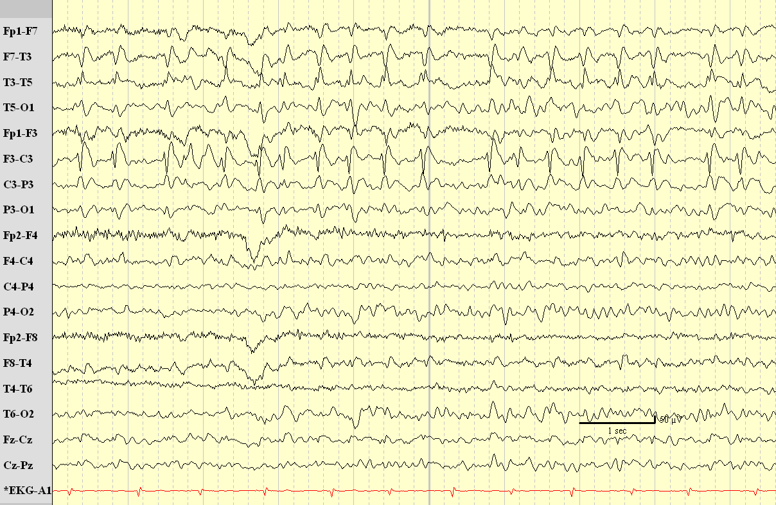
Centrotemporal spikes in Benign Rolandic Epilepsy

Slide 27
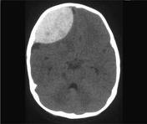
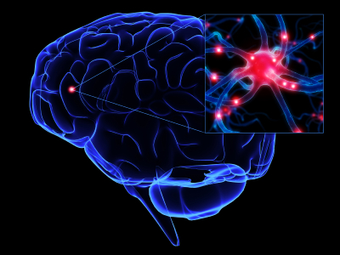
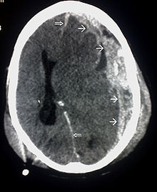
Posttraumatic Epilepsy
Early PTE
Late PTE

Slide 28
Posttraumatic Epilepsy
Early posttraumatic epilepsy
  Seizures occurring 7 days within injury
  Should be treated promptly
  IV phenytoin is the typical drug of choice
  More recently levetiracetam

Slide 29
Early Posttraumatic Epilepsy
Indication of severe brain injury
The seizure may lead to more brain damage
  Releases excitatory neurotransmitters
  Increases metabolic need of brain
  Increases intracranial pressure
The seizure is a reaction to the injury
Other causes include cerebral edema, intracranial hemorrhage, cerebral contusion

Slide 30
Posttraumatic Epilepsy
Late posttraumatic epilepsy
  Seizures occurring more than 7 days after injury
  Treatment is not mandatory
Seizures occur as a result of scarred neurons, permanent changes in the brain.
Anti-epileptic medications given in early phase do not reduce risk of developing late PTS, ie PTE

Slide 31
Evaluation of a
1st unprovoked seizure

Slide 32
Good evidence recommends EEG
  EEG can help diagnose the event
  EEG can identify a specific syndrome
  EEG can help with prognosis
  timing of EEG not determined
    immediate EEG may show abnormality or post ictal slowing
  abnormal EEG best predictor of recurrence in neurologically normal children
  abnormal neuro exam also strong predictor of recurrence

Slide 33
Evaluation of a
1st unprovoked seizure
  consider emergent imaging
    if postictal focal deficit, or not at baseline in several hours
  consider nonurgent MRI
    with significant neuro abnormalities of unknown etiology
    a seizure of focal onset
    in children under 1 year of age
  consider LP
    in the very young child (<6 months)
    in the patient who fails to return to baseline
    in any patient with meningeal signs
    if increased ICP suspected, image before LP

Slide 34
How likely is a 2nd seizure?
Recurrence ranges from 14%-65%
Most recurrences early (in 1st year)
Factors increasing recurrence risk
  abnormal EEG
  etiology
    remote symptomatic seizure recurrence >50%
    idiopathic seizure recurrence 30-50%

Slide 35
Treatment Plan

Slide 36
Treatment
Find the Right Medication
  Partial Epilepsy
    Tegretol, Trileptal, Lamictal, Dilantin. Keppra, Topamax, Vimpat, Sabril, neurontin
  Generalized Epilepsy
    Depakote, Vimpat, Onfi, Epidiolex, Lamictal, Klonopin, Keppra, Topamax, Zonegran, Phenobarbital
Start with Monotherapy
  Add additional medications as needed, the fewer the better
  Rarely are patients treated with more than 2 medications
Consider resective surgery
  Partial epilepsy---mainly temporal
  Extra-temporal with lower chance of response

Slide 37
Treatment of
Status Epilepticus
Making the diagnosis
  May be difficult because continuous seizure activity may be hard to distinguish from altered cognitive function of any cause.
  EEG may help as can response to medications.
ABC’s
  The most important part of treatment

Slide 38
Initial Pharmacologic Management of Status
  Fosphenytoin (Dilantin)
    20mg/kg IV
      If the seizures have stopped consider PO loading to avoid side effects (hypotension, cardiac arrest, local irritation)
    This typically yields a level of 15-20
  Valproic Acid 15 mg/kg q8 hours times 3
  Phenobarbital 20 mg/kg load
  Levetiracetam – dosing not established
  Lacosamide

Slide 39
Precautions
Need cardiac monitoring and frequent vital signs during infusion of phenytoin or phosphenytoin.
  Hypotension is common
  Cardiac arrythmias may occur with either
  Local irritation with phenytoin
  May need to change infusion rate

Slide 40
Initial Pharmacologic
Management of Status
If seizures continue:
  Additional Benzodiazepine as Tolerated
    unless a patient is known to be tolerant, more than 0.2mg/kg (up to 8-10mg in an adult) of lorazepam will generally cause severe respiratory depression
  Phenytoin Additional Dose
    10mg/kg
    This typically produces levels on the order of 20-25 mg/dl
    Valproic Acid IV
    Topamax NGT
    Keppra IV

Slide 41
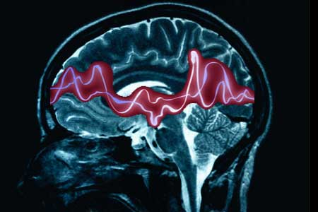
Patient Cases

Slide 42
Use of drug-induced coma
Born twin at 31 WGA, weighed 3 # 1 oz
Prolonged course in NICU with respiratory distress
Head US revealed hydrocephalus and periventricular leukomalacia
No seizures while in NICU
Placed in birth to 3 therapies when discharged home

Slide 43
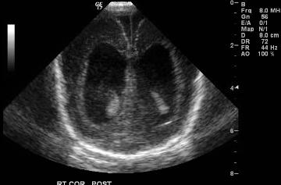
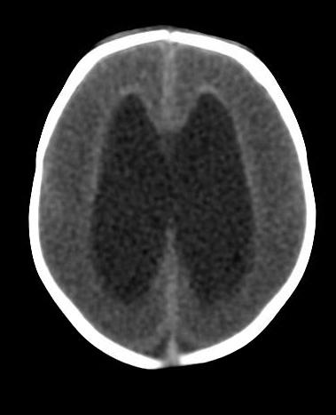

Slide 44
One day, her father found her unresponsive and she was brought to the ER by EMS
EMS documented a blood glucose of 14
Upon arrival to ER, she began convulsing and was intubated
Glucose was corrected but she continued to have seizure activity

Slide 45
Patient was loaded with dilantin, 20 mg/kg
Level after load was 23
EEG urgently performed and she was monitored continuously in the PICU
The patient continued to have seizures despite a load of phenobarbital, topamax and scheduled ativan

Slide 46
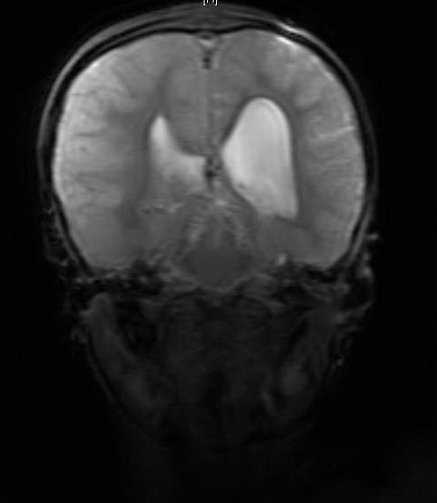
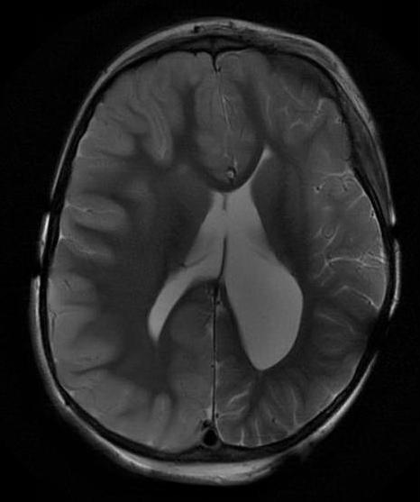
MRI brain revealed new right hemisphere infarction, likely due to a complication from hypoglycemia

Slide 47
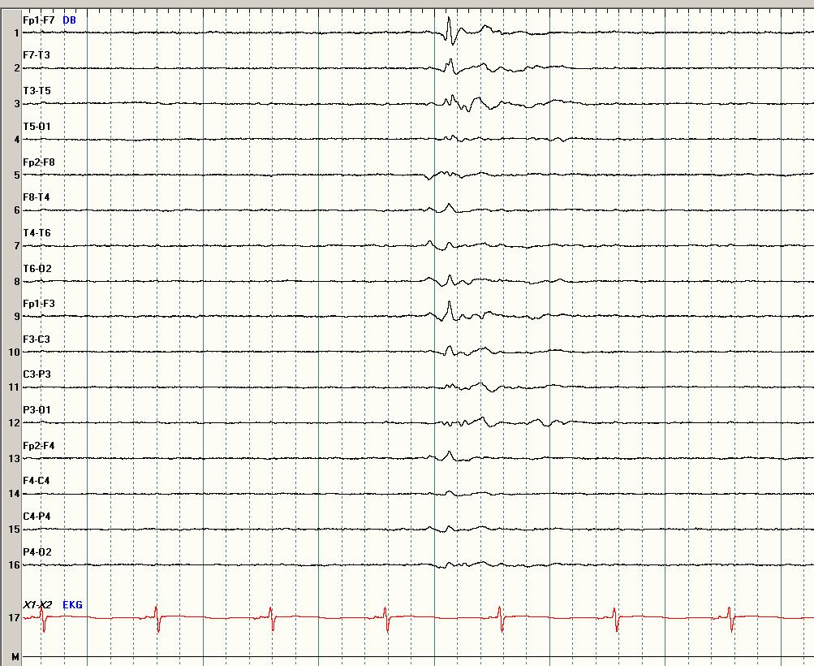
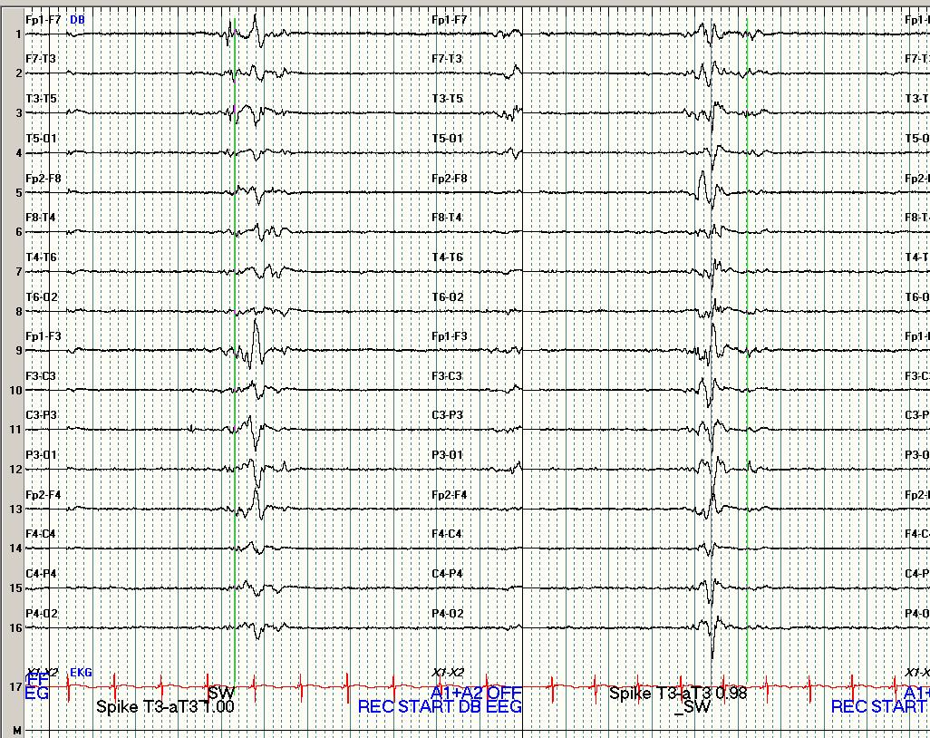
Decision was made to place her in a pentobarbital coma to achieve burst suppression

Slide 48
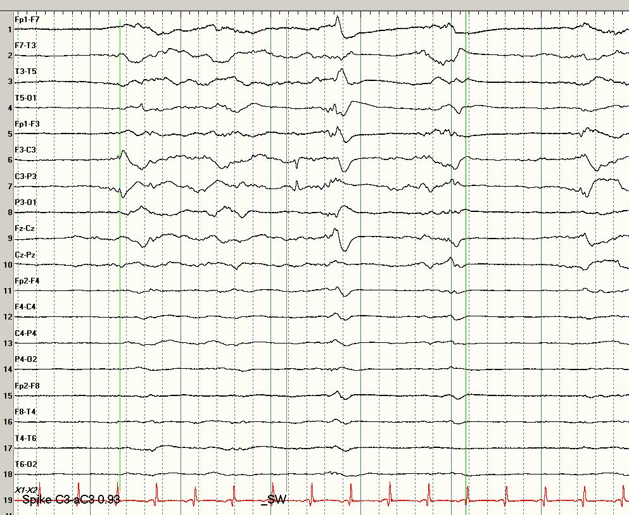
After 4 days of pentobarbital, the intensivists had a difficult time maintaining adequate blood pressure. She had achieved burst-suppression pattern for over 48 hours, so she was weaned off pentobarbital over the next 24 hours
EEG gradually became more responsive, focal spikes recurred, but no seizures

Slide 49
She was transferred to an inpatient rehabilitative facility on topamax and dilantin.
She underwent a complete metabolic and endocrinologic evaluation for hypoglycemia; no etiology was found

Slide 50
Burst-Suppression EEG
Maximal cerebral metabolic reduction in animals associated with isoelectric EEG
Commonly thought that burst-suppression EEG metabolically equivalent to isoelectric EEG
Hypothermia decreases amplitude of bursts and prolongs periods of suppression

Slide 51
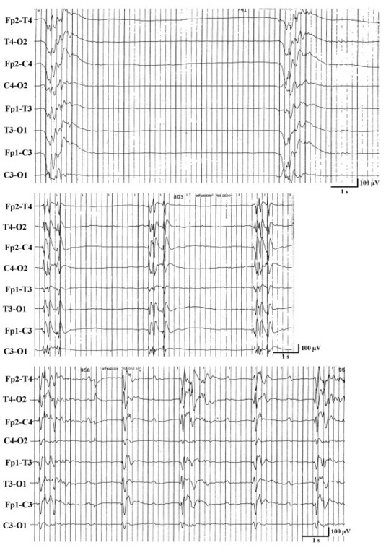
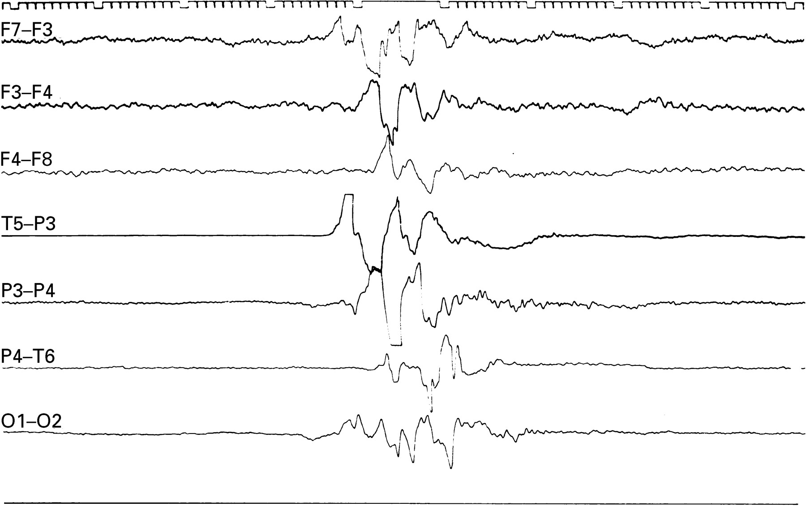
Burst-Suppression

Slide 52
Lesional Epilepsy – case 1
14 year old female who began having seizures described as right hand twitching
MRI brain revealed tumor in left temporal lobe

Slide 53
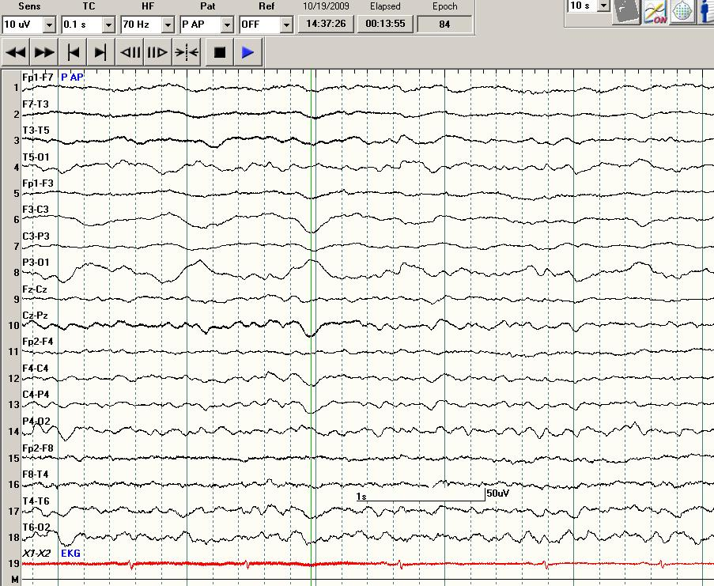
Scalp EEG revealed slowing

Slide 54
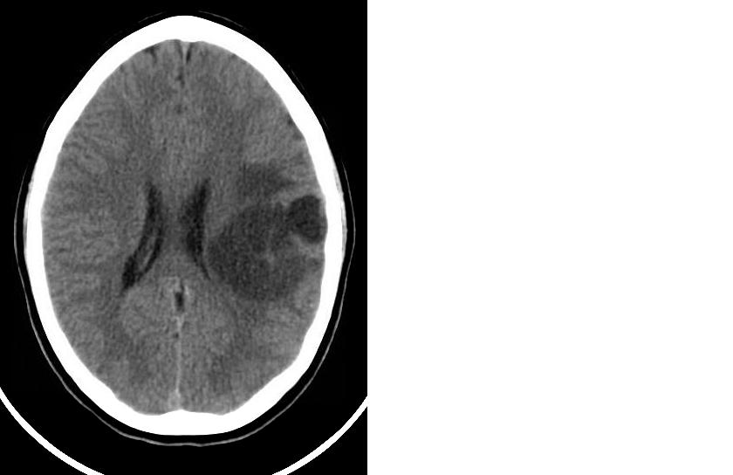
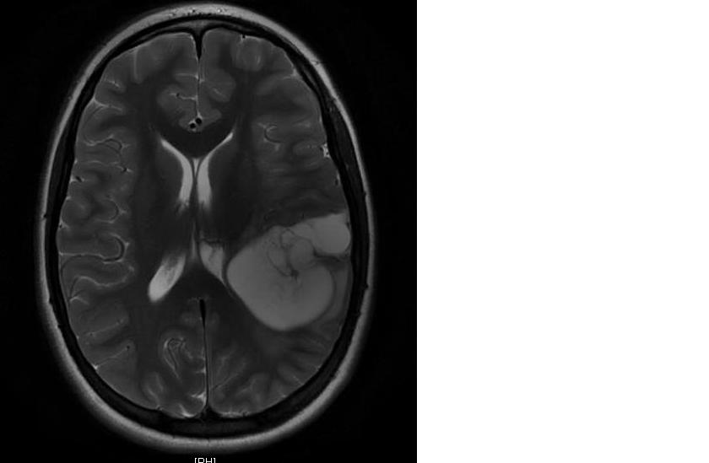
Neuroimaging revealed left temporal lobe tumor
CT
MRI

Slide 55
Tumor appeared benign and was not causing any edema or secondary problems
Immediate resection was not performed
Patient was started on keppra for seizure activity, however, seizures continued

Slide 56
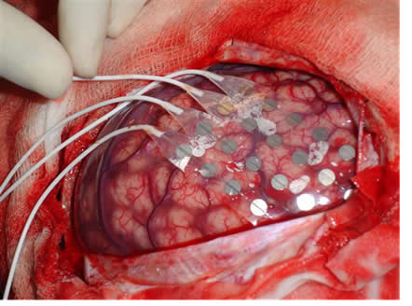
Decision made to remove tumor
Patient underwent electrocorticography

Slide 57
Cortical EEG revealed spikes in adjacent cortex
Tumor and this surrounding area were removed

Slide 58
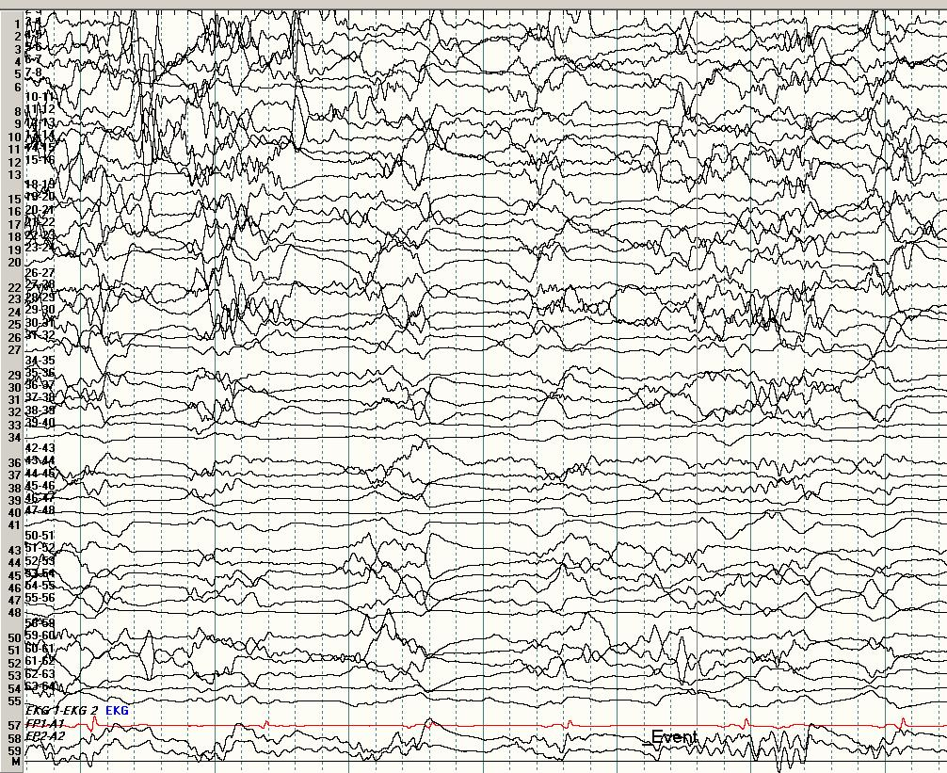
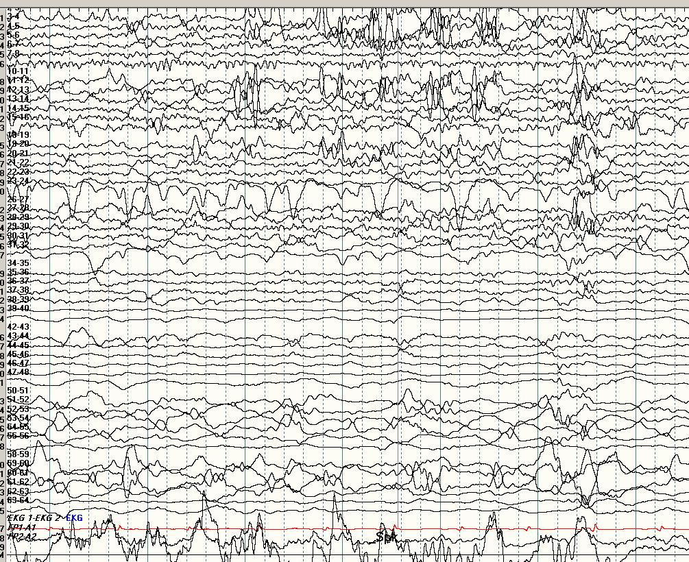
EEG cortical recording
Seizure
Inter-ictal spikes

Slide 59
Pathology revealed tumor to be a low grade astrocytoma
After surgery, patient did well and was continued on keppra for about 6 months
Keppra was then weaned and she has done well

Slide 60
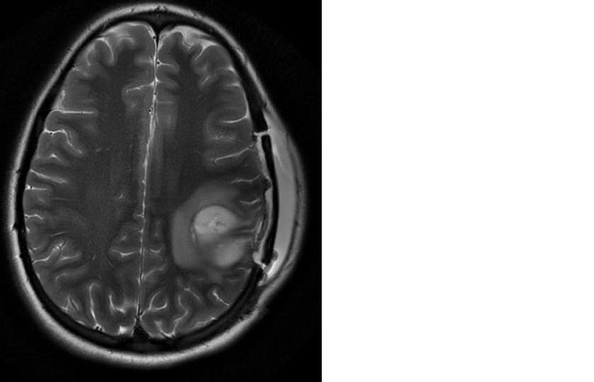
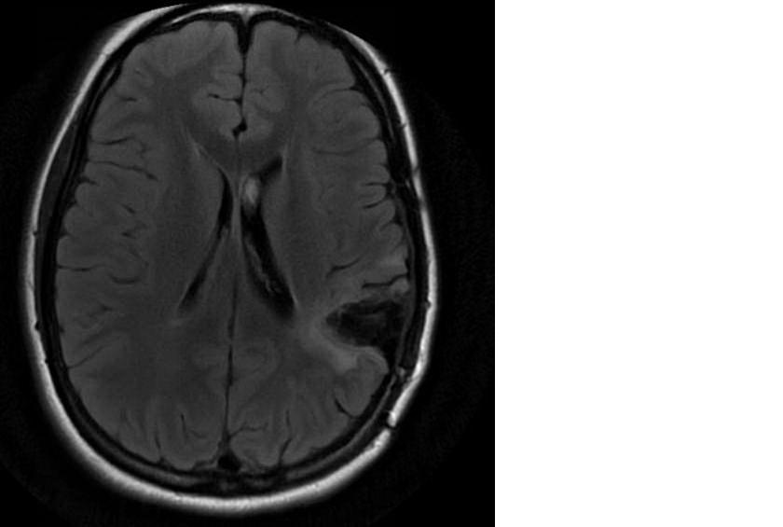
Follow- up scans
MRI one week after surgery
MRI one year after surgery

Slide 61
Lesional Epilepsy – case 2
6 month old female presented to ER with rash and irritability
Lumber puncture was bloody so CT scan performed
CT and MRI revealed large right temporal lobe tumor

Slide 62
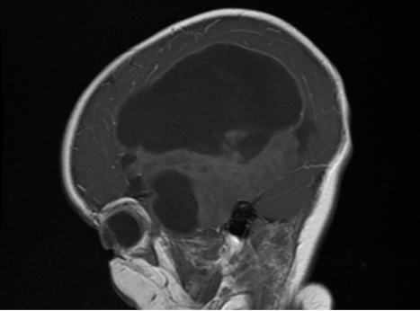
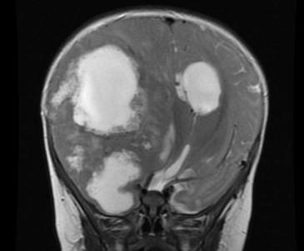
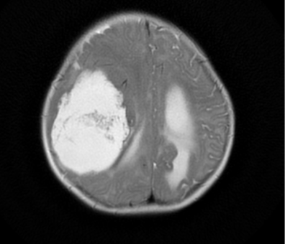
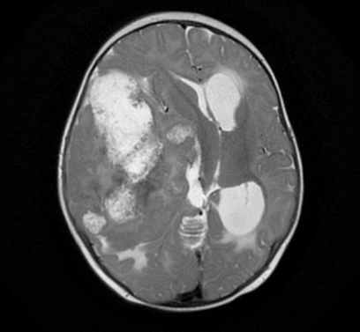
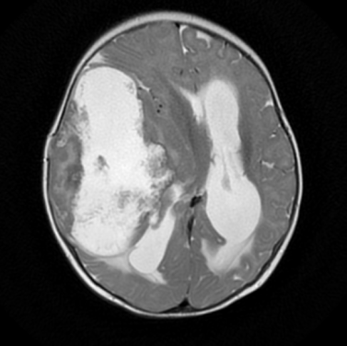
MRI

Slide 63
Examination was significant for left esotropia, present since birth
Mild increased tone left arm and leg
Left ankle clonus
No history of seizures

Slide 64
Hospital Course
Patient underwent partial resection
Pathology revealed grade 3 anaplastic ependymoma
About 2 weeks after surgery, episodes of staring and left extremity twitching were noticed
Interictal EEG showed frequent right hemisphere slowing, spikes, and attenuation
Ictal EEG demonstrated right hemisphere seizure

Slide 65
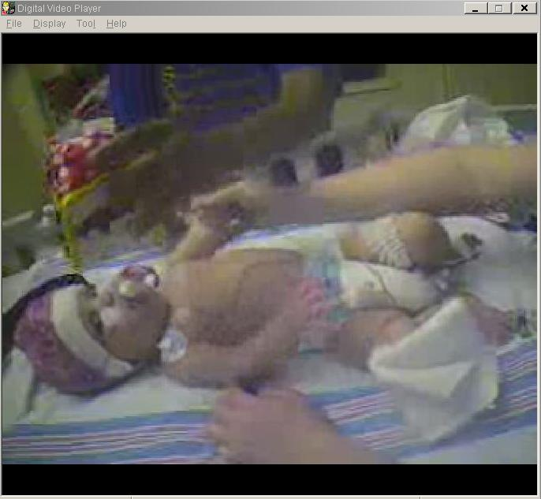
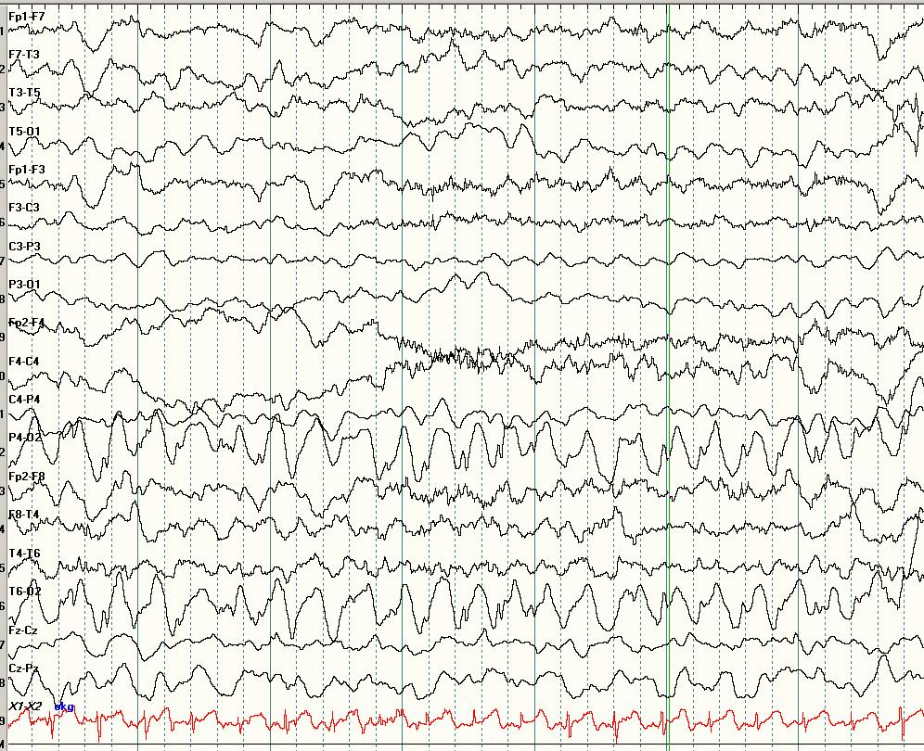
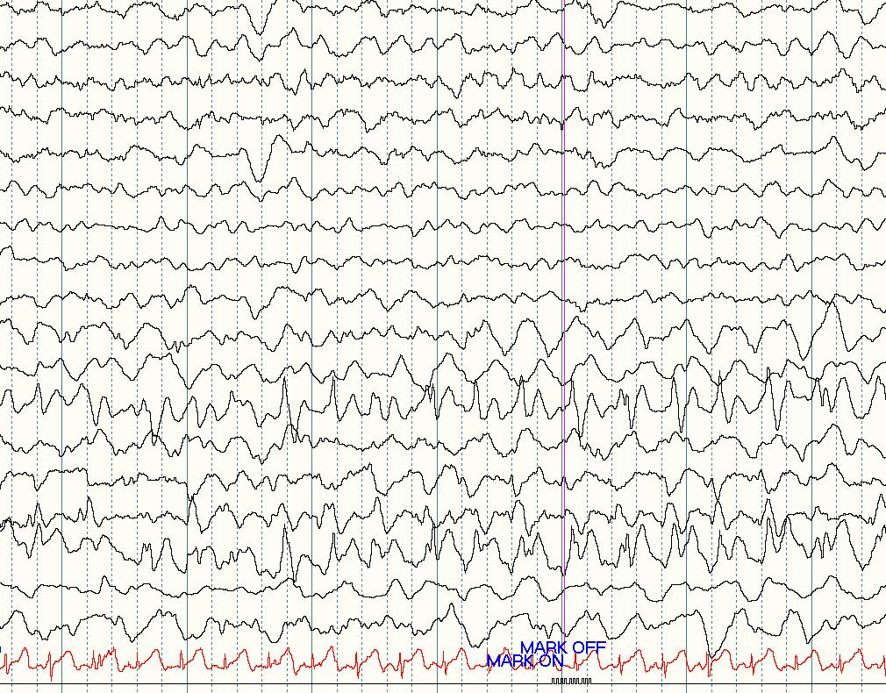
EEG

Slide 66
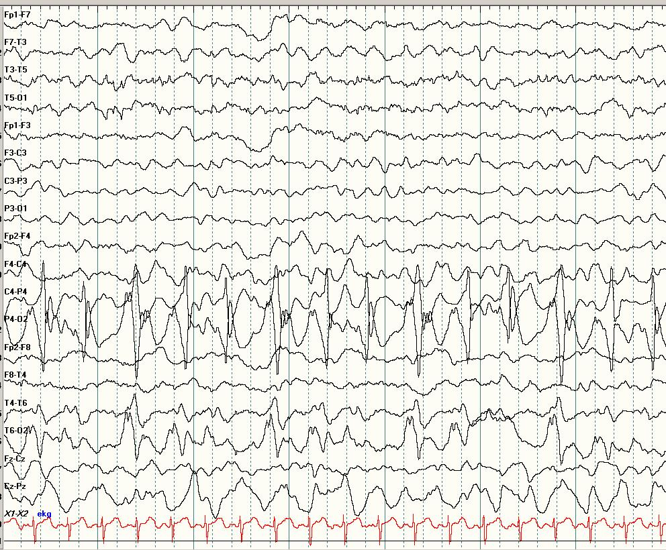
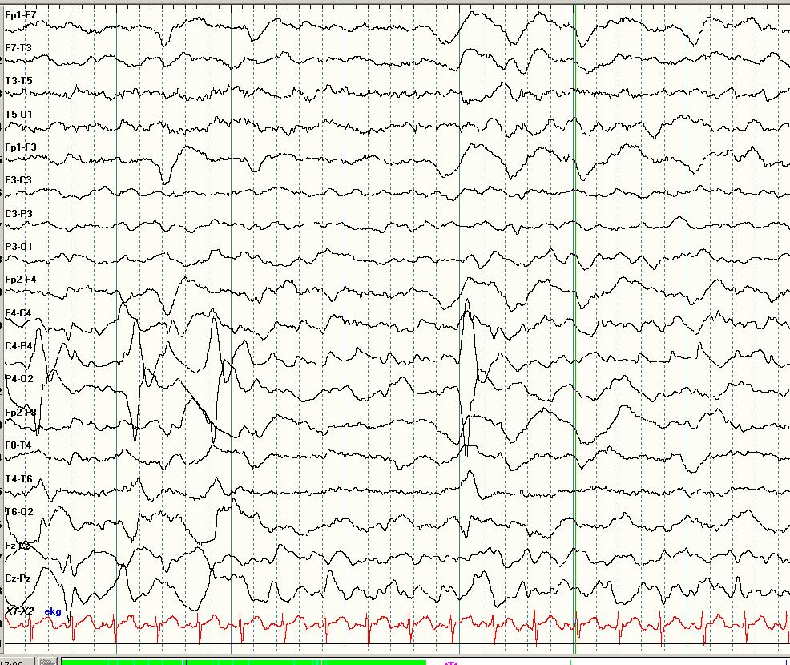

Slide 67
Treated with levetiracetam
Rare seizures
Underwent chemotherapy and radiation, doing well

Slide 68
Thank you

