Slide 1
Medical Cannabis
Dr. William Troutt N.D.
Trulieve Lead Medical Director

Slide 2
Objectives
Review cannabis laws and WV medical cannabis program
Discuss medical cannabis science
Identify available forms of cannabis medicines and potencies
Recognize pharmacokinetics of different routes of administration
Discuss titration and dosing strategies

Slide 3
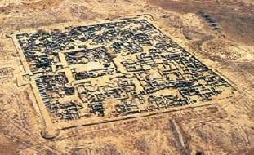
Bactria Margiana
2300–1700 BCE
1.Sarianidi, V. I. "Issledovanija pamjatnikov Dashlyiskogo Oazisa," in Drevnii Baktria, vol. 1. Moscow: Akademia Nauk. 1976
Notes:
Bronze age culture of central Asia, Northern Afganastan, escavated in late 1970

Slide 4
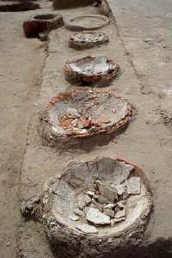
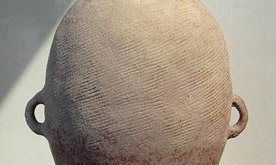
EARLY CANNABIS DISPENSARY
1.Sarianidi, V. I. "Issledovanija pamjatnikov Dashlyiskogo Oazisa," in Drevnii Baktria, vol. 1. Moscow: Akademia Nauk. 1976

Slide 5
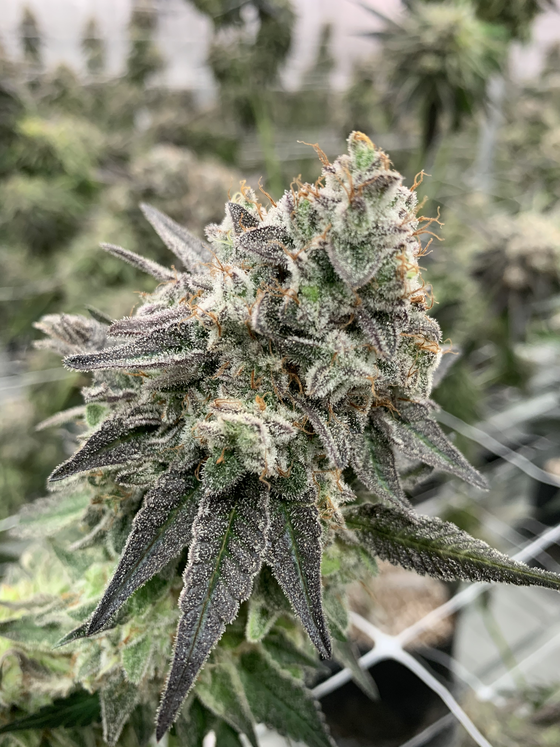
Cannabis Sativa L.
Carl Von Linneaus
  Formalized system of naming organisms, “Binomial Nomenclature”
  Described Cannabis Sativa in “Species Planetarium”, 1753
  Sativa means cultivated.
Jean-Baptiste Lamarck
  Proposed two species of Cannabis, 1785
    Cannabis Sativa, cultivated in western regions
    Cannabis Indica, a wild species growing in India and eastern countries
  McPartland JM. Cannabis Systematics at the Levels of Family, Genus, and Species. Cannabis and Cannabinoid Research 2018, 3.1 http://online.liebertpub.com/doi/10.1089/can.2018.0039
Notes:
We are moving past the sativa versus indica species subspecies debate to a classification system based on the constituent profile or chemotype.

Slide 6
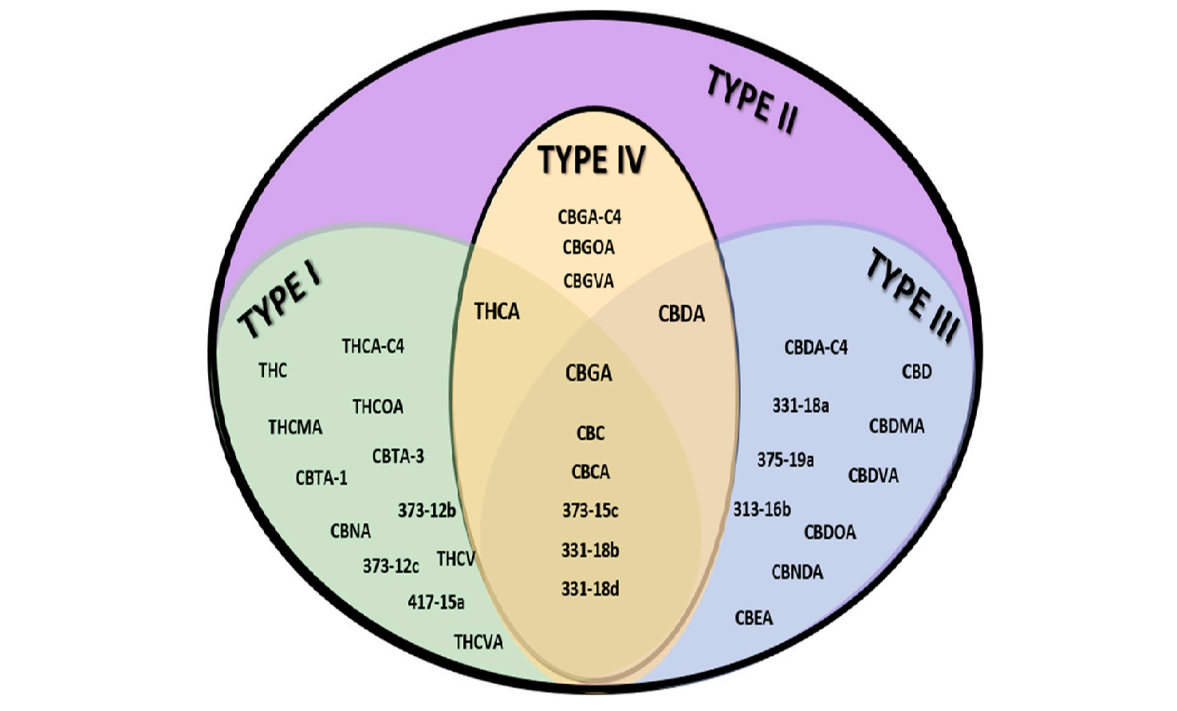
Cannabis Sativa L.
Chemotype Classification
  Type I
    THC Dominant
  Type II
    CBD:THC Balanced
  Type III
    CBD Dominant
  Type IV
    CBGA Dominant
Hundreds of cultivars worldwide
  500+ secondary metabolites
Distribution of Cannabinoids to Chemovar
Procaccia S, Lewitus GM, Lipson Feder C, Shapira A, Berman P and Meiri D (2022) Cannabis for Medical Use: Versatile Plant Rather Than a Single Drug. Front. Pharmacol. 13:894960. doi: 10.3389/ fphar.2022.894960

Slide 7
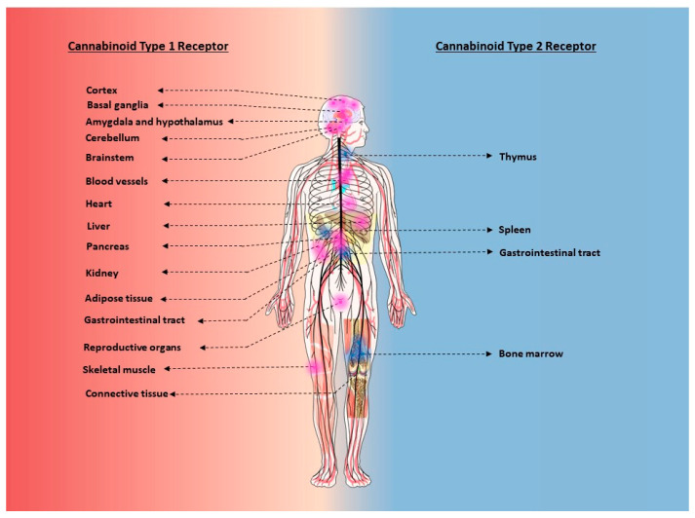
The Endocannabinoid System
The ECS is a lipid communication system that regulates several biological processes such as cognitive function, sleep, pain, immune responses, and eating.
Cannabinoid Receptors - G protein coupled receptors
  Cannabinoid 1 Receptors (CB1) - Neuromodulation
    Central and Peripheral Nervous System
      Presynaptic axons
      Retrograde regulation of synaptic transmission
      Reduce neurotransmitter release
  Cannabinoid 2 Receptors (CB2) - Immunomodulation
    Immune cells and Lymphoid Tissue
      Regulation of humoral and cell mediated immunity
      Immunosuppression
      Apoptosis
Howlett AC, Abood ME. CB₁ and CB₂ Receptor Pharmacology. Adv Pharmacol. 2017;80:169-206. doi:10.1016/bs.apha.2017.03.007

Slide 8
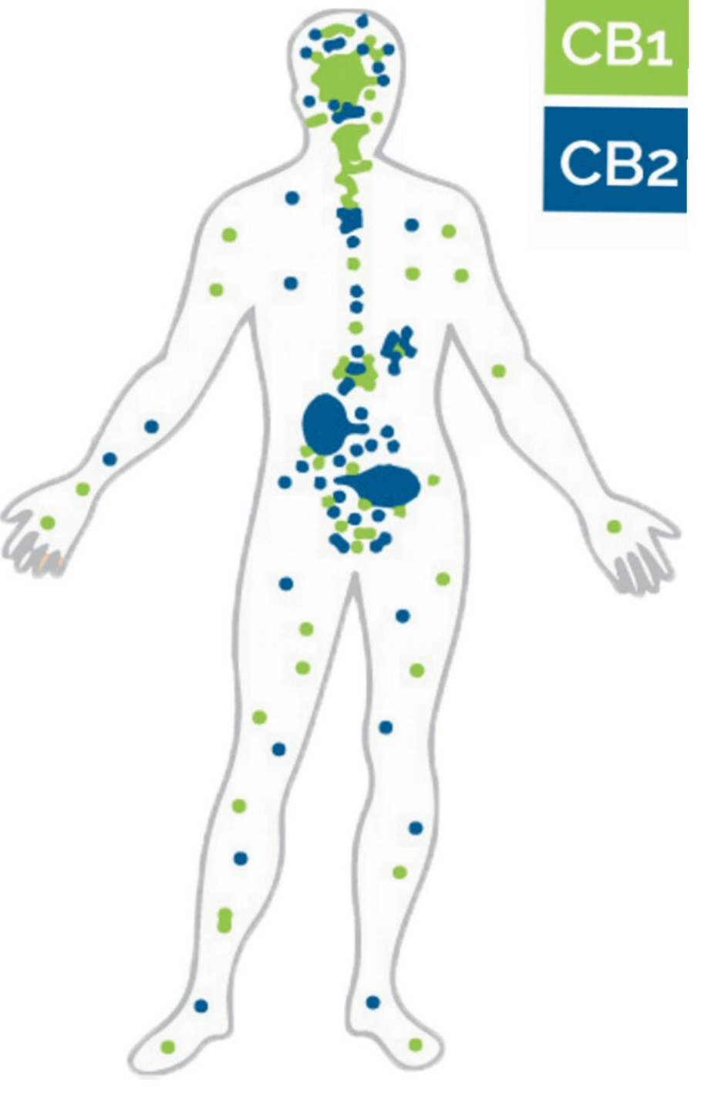
The Endocannabinoid System
Endocannabinoids are endogenous messengers produces on demand from phospholipid precursors in the cellular membrane of post synaptic neurons, glia and other cells.
Endocannabinoids
  Anandamide, N-arachidonoylethanolamine
    CB1 partial agonist high affinity
    full agonist of TRPV1
    Degraded by fatty acid amide hydrolase (FAAH)
  2-AG, 2-arachidonoylglycerol
    CB1/CB2 full agonist moderate to low affinity
    Degraded by monoglyceride lipase (MGL)
Notes:
Both AEA and 2-AG have been reported to interact with various receptors.

Slide 9
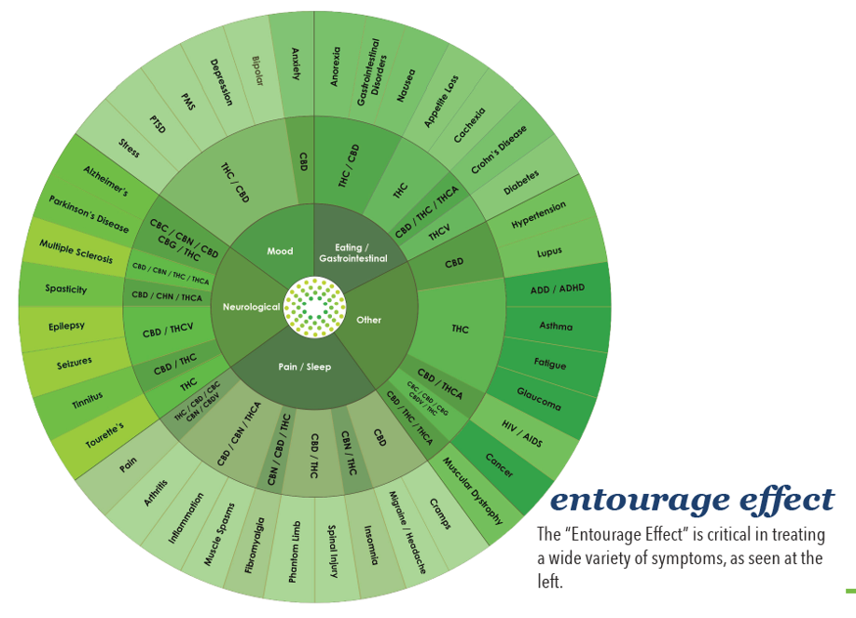
Cannabinoids
THC, Tetrahydrocannabinol
  Psychoactive
  CB1/CB2 agonist
  Pain, Muscle spasms, Appetite, Nausea
CBD, Cannabidiol
  Non-Impairing
  Antagonizes CB1/CB2 Agonists
  5-HT1a agonist
  TRPV agonist
  FAAH inhibitor
  Pain, Anxiety, Inflammation, Seizures
CBN, Cannabinol
  Oxidative product of THC
  Synergistic sedative effects
CBG, Cannabigerol
  Pain, Inflammation

Slide 10
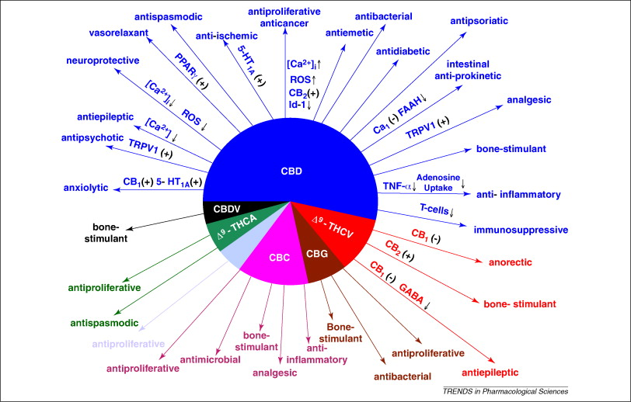
Cannabinoids
THCA
Tetrahydrocannabinolic Acid
  Non-psychoactive
  Heat converts to psychoactive THC
    Decarboxylation
CBDA
Cannabidiolic Acid
Izzo AA, Borrelli F, Capasso R, DiMarzo V, Mechoulam R. 2009. Non-psychotropic plant cannabinoids: new therapeutic opportunities from an ancient herb. Trends Pharmacol Sci

Slide 11
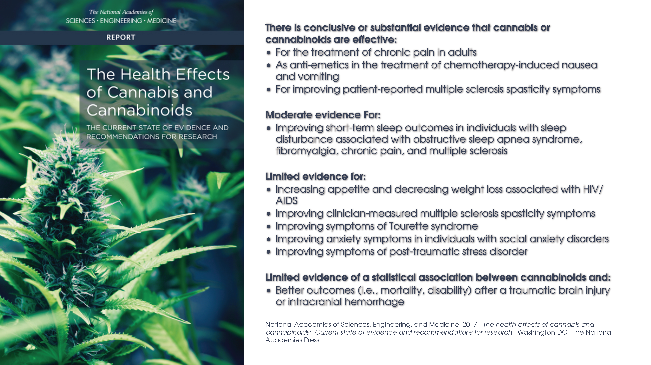

Slide 12
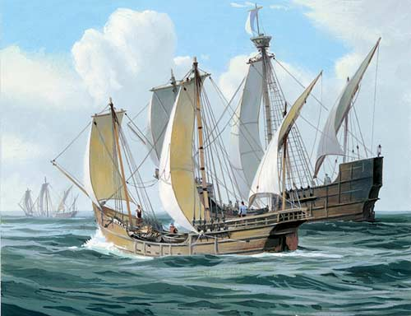
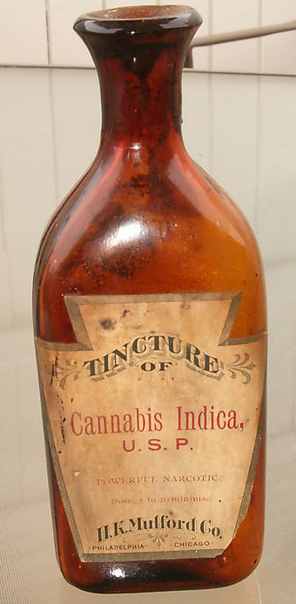
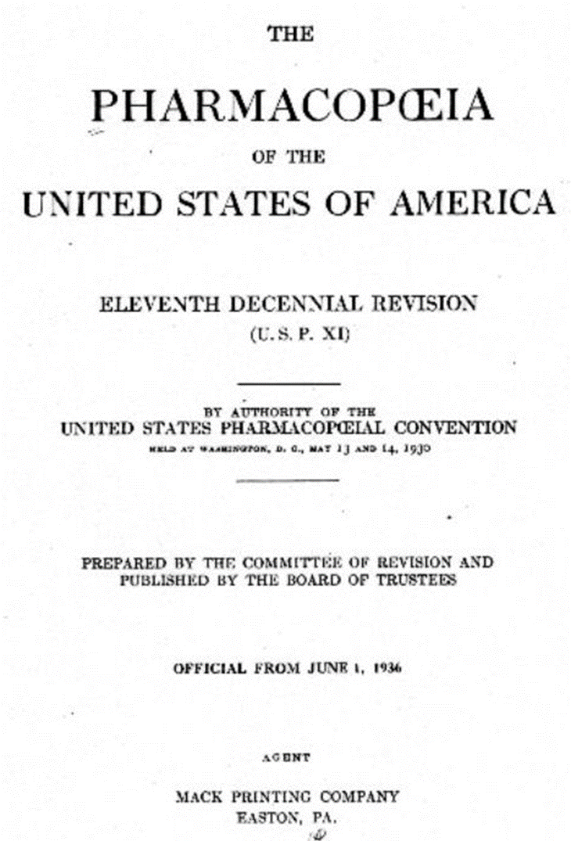
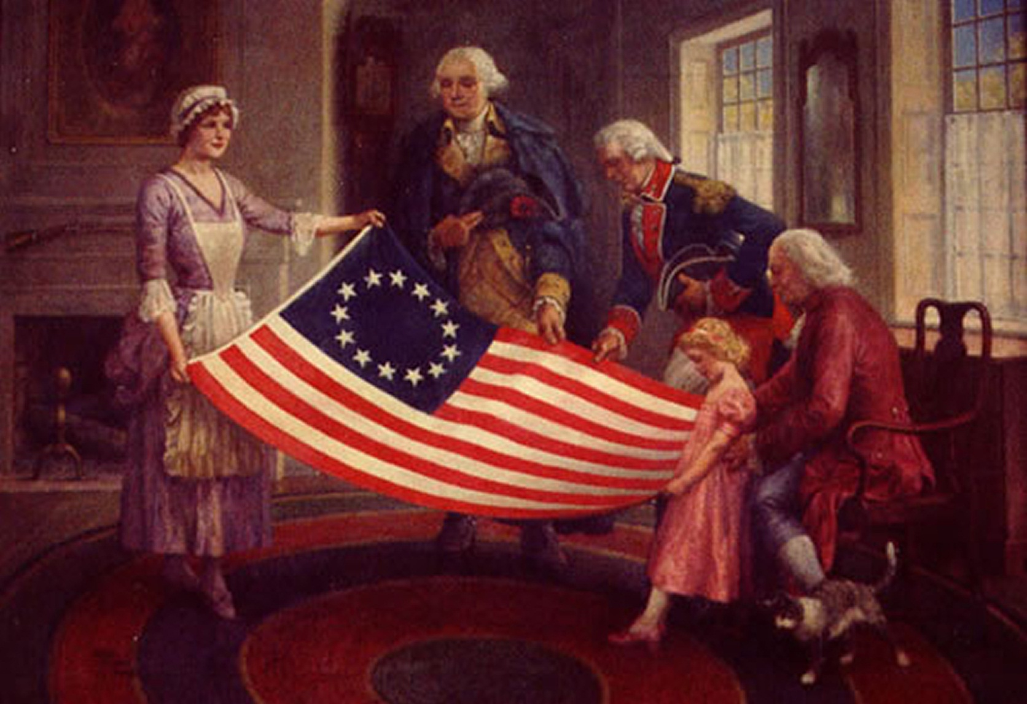
AMERICAN HISTORY

Slide 13
WV Medical Cannabis Act
Senate Bill 386, signed into law on April 19, 2017, created the Medical Cannabis Act.
Allowing physicians to certify medical cannabis use by a West Virginia resident with a “serious medical condition”.
Physician participation requires:
  Hold a valid West Virginia license to practice medicine
  Submit an online application to the Bureau for Public Health, Office of Medical Cannabis
  Successfully complete the required four-hour CME course established by the Bureau
West Virginia Department of Health and Human Resources, Office of Medical Cannabis. https://omc.wv.gov/

Slide 14
Qualifying Serious Medical Conditions
Cancer
Aids, HIV+
Amyotrophic Lateral Sclerosis
Parkinson’s Disease
Multiple Sclerosis
Spinal cord Injury with Intractable Spasticity
Epilepsy
Neuropathies
Huntington’s Disease
Crohn’s Disease
Post Traumatic Stress Disorder
Intractable Seizures
Sickle Cell Anemia
Pain, Severe Chronic or Intractable
Terminally Ill
https://omc.wv.gov/

Slide 15
Approved Forms of Medical Cannabis
(A) Pill;
(B) Oil;
(C) Topical forms, including gels, creams or ointments;
(D) A form medically appropriate for administration by vaporization or nebulization, including dry leaf or plant form;
(E) Tincture;
(F) Liquid; or
(G) Dermal patch.
It shall be unlawful to:
(1) Smoke medical cannabis.
(2) Except as provided under subsection (c), incorporate medical cannabis into edible form or sell in edible form.(c) Edible medical cannabis. — Nothing in this act shall be construed to preclude the incorporation of medical cannabis into edible form by a patient or a caregiver in order to aid ingestion of the medical cannabis by the patient.
https://omc.wv.gov/

Slide 16
Patient Preferences and Product Knowledge
Cannabis Use Preferences and Decision-making Among a Cross-sectional Cohort of Medical Cannabis Patients with Chronic Pain
  1321 survey participants
  93.4% used two modes of administration
  72.5% used 3 modes of administration
  Only 2.6% selected cannabis products with input from a medical professional
  Boehnke KF, Scott JR, Litinas E, Sisley S, Clauw DJ, Goesling J, Williams DA. Cannabis Use Preferences and Decision-making Among a Cross-sectional Cohort of Medical Cannabis Patients with Chronic Pain. J Pain. 2019 Nov;20(11):1362-1372. doi: 10.1016/j.jpain.2019.05.009. Epub 2019 May 24. PMID: 31132510
Knowledge of Tetrahydrocannabinol and Cannabidiol Levels Among Cannabis Consumers in the United States and Canada
  6471 survey participants
  Only 10% of dry herb consumers reported the THC percentage
  Less than a third of consumers were able to report the numeric THC and CBD levels of their products
  Hammond D, Goodman S (2020) Knowledge of tetrahydrocannabinol and cannabidiol levels among cannabis consumers in the United States and Canada, Cannabis and Cannabinoid Research X:X, 1–10, DOI: 10.1089/can.2020.0092.
Notes:
Studies show that patients are using a variety of cannabis products and modes of administration but knowledge of THC and potency levels are low.

Slide 17
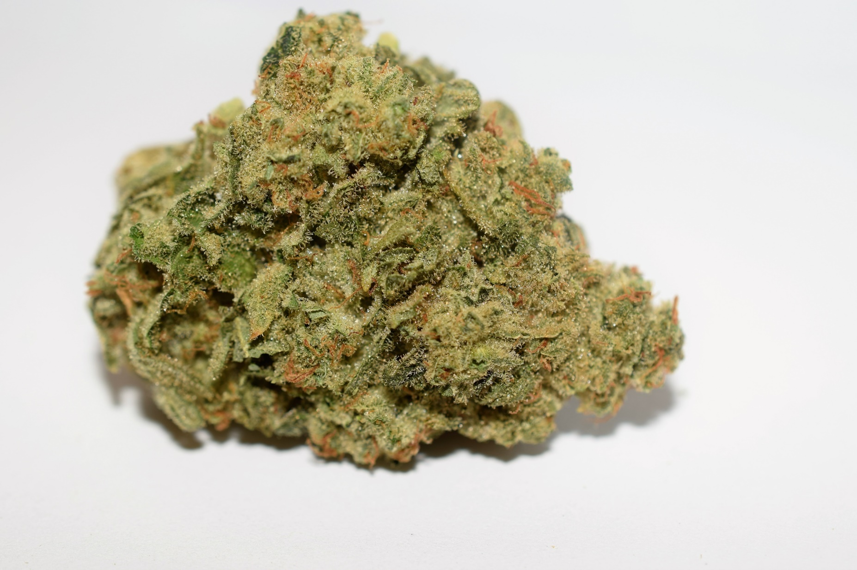
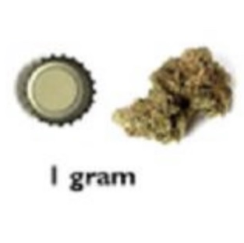
Flower
Varieties
  Type I
    THC Dominant
      Sativa
      Indica
      Hybrid
  Type II
    CBD:THC Balanced
  Type III
    CBD Dominant
Potency
  Cannabinoid Content labeled by percent plant weight
    10-30% flower weight
    1 gram of 10% CBD/THC Cannabis Flower contains 100mg CBD/THC
Photo Sourced from International Cannabis Policy Survey
Hammond D, Goodman S, Leos-Toro C, Wadsworth E, Reid JL, Hall W, Pacula R, Driezen P, George T, Rehm J, Werb D, Boudreau C, Porath A, Abramovich H, Elliot R. International Cannabis Policy Study Wave 1 Survey (2018). August 2018.
Notes:
THC dominant Type 1 chemotype is the most common and available flower variety at dispensaries
Flower is most commonly inhaled but may be consumed orally.
Routes of Admin
Oral – raw
Cann Acids
Or heated
Tea

Slide 18
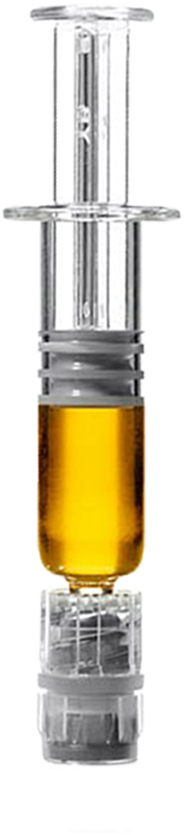
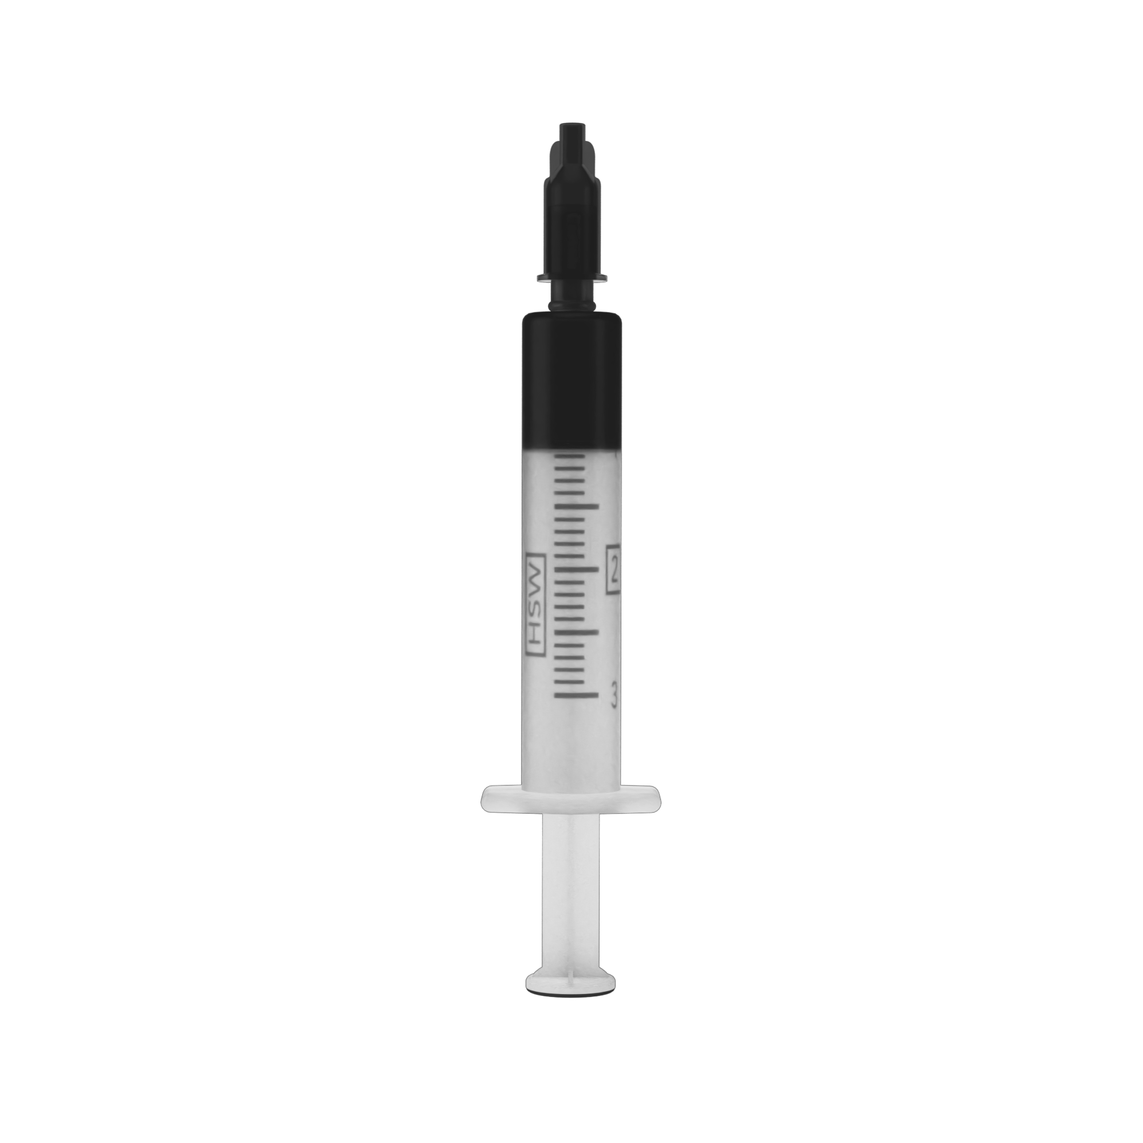

Concentrates
Extraction and separation of constituents from plant material
  Potency
    Products typically labeled by percent cannabinoid content
    60% - 80% average cannabinoid content by product weight
    Distillates may reach upper 90% Cannabinoid Content
    1 gram of 80% CBD/THC concentrate contains approximately 800mg CBD/THC
  Capsules
    2.5mg - 50mg Cannabinoid Content Common
  Syringe
    Full Spectrum OIL
    Rick Simpson OIL (RSO)
        Whole Plant
Notes:
Concentrate Extractions are the most versatile form of the medicine and can be administered through inhalation, orally and topically
Label cartridges with sharpie

Slide 19
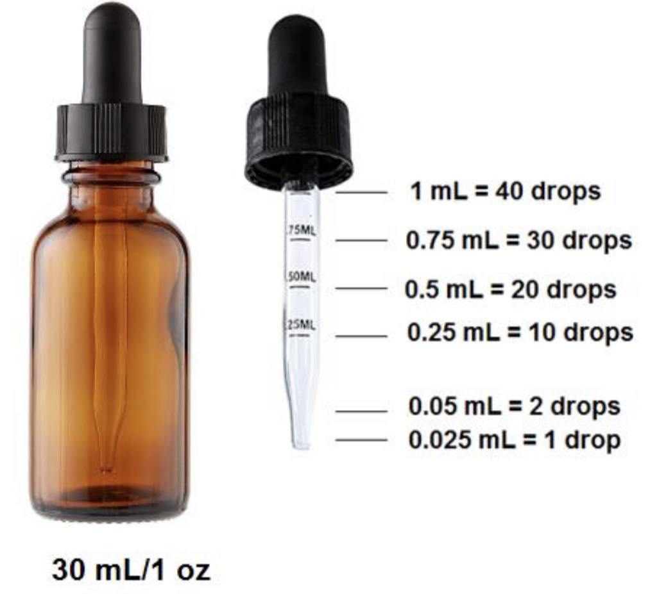
Formulations
Tinctures
  Cannabis extractions in liquid solutions
    Ethanol
    Vegetable Glycerin
    Fractionated Coconut Oil (MCT)
    Olive Oil, Hemp Oil, Safflower, Sunflower, and more
  Potency
    Milligrams Cannabinoids Per Milliliter Solution
    Example: 500mg THC Per 1floz solution
      500mg THC ÷ 30ml = 16.66 mg THC Per mL
      16.66 mg ÷ 40 drops = .41 mg THC Per Drop
Photo Sourced from International Cannabis Policy Survey
Notes:
Tinctures are traditionally ethanol extractions but in dispensaries are found most commonly suspended in vegetable glycerin or fractionated coconut oil known as MCT – medium chain triglycerides.
1oz/ 30ml bottles are most common with approximately 40 drops/milliliter or dropper. 500mg of cannabinoids per oz is a middle of the road potency with TYPE 1,2,3 chemotypes readily available.

Slide 20
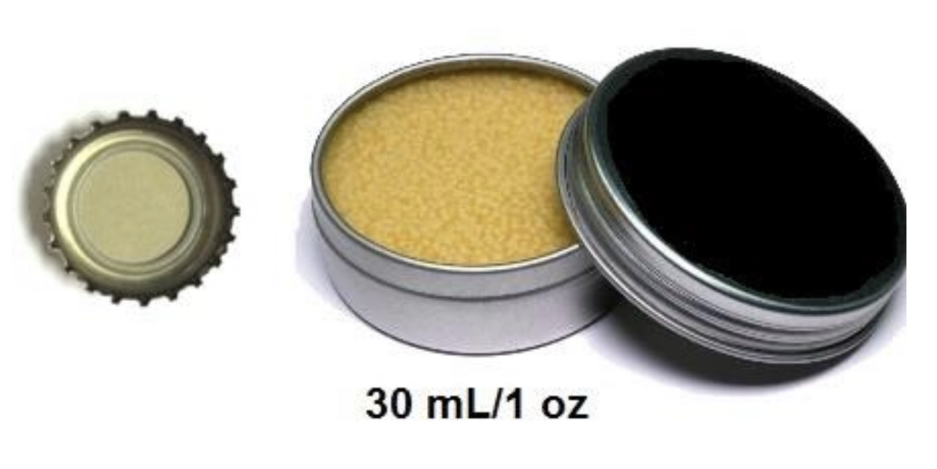
Formulations Cont’d
Topicals
  Cannabinoids labeled by milligrams in container or by percent content
    Quantify dose in dime size dollops
    Other botanical mixtures common
  Dermal
    Lotions, Salves, Balms
      Local effects
  Transdermal
    Gels
    Patches
      Long lasting systemic effects
Photo Sourced from International Cannabis Policy Survey
Notes:
Cannabinoids in topicals may be labeled by mg per container or percent content. I ask patients to quantify dose by a dime sized dollop.
Dermal lotions salves and balms are available without systemic effects and gels and transdermal patches with permeability enhancers are designed for systemic effects.
Transdermal penetration Enhancers
propylene glycol

Slide 21
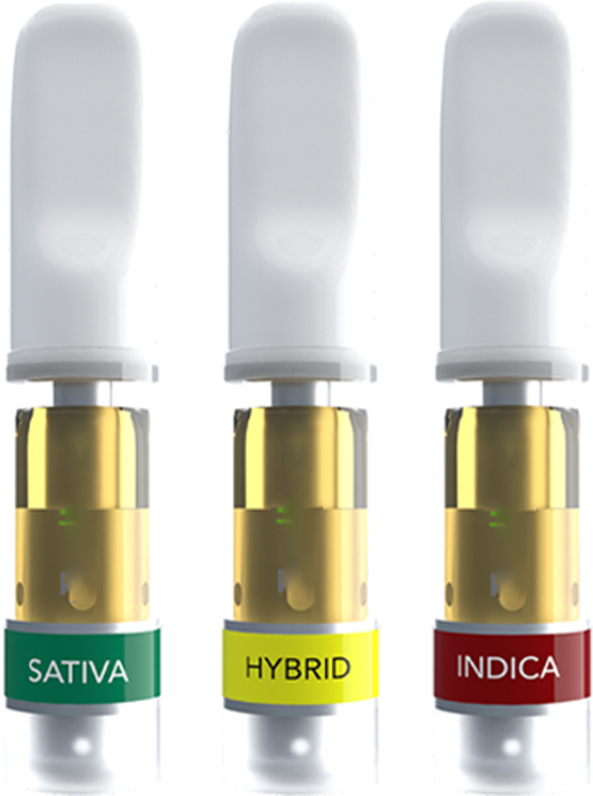
Routes of Administration
Inhalation
  Bioavailability
    Range 2-56%, 10-35% in experienced subjects
  Plasma concentrations
    Peak 3-10 minutes after Inhalation
  Perceived Effects
    Onset 5-10 minutes
    Duration 2-4 hours
      Grotenhermen, F. Pharmacokinetics and pharmacodynamics of cannabinoids. Clin. Pharmacokinetics. 2003, 42, 327–360.
      See review for references of pharmacokinetic studies
Notes:
Inhalation has the greatest bioavailability with a range of 2-56%, 10- 35% in experienced users.
The quick onset of seconds to 10 minute allows patients to easily evaluate the desired dose with a relatively short duration of approximately 2-4 hours.

Slide 22
Routes of Administration Cont’d
Oral
  Bioavailability
    4-12%
    Consuming cannabinoids with fatty foods can increase bioavailability 4-fold (Birnbaum et al., 2019)
  Maximum Plasma Concentrations
    60 – 120 minutes
    Large Interindividual variability
  Perceived Effects
    Onset 60 – 180 minutes
    Duration 6-8 hours
  Significant degradation of THC assumed in stomach acids
    Half life of 1hour at PH 1.0
      See Grotenhermen et al. 2003 review for pharmacokinetic references
Notes:
There is a low bioavailability of 4-12% and large interindividual variability with oral dosing. onset ranges from 1-3 hours and duration 6-8+ depending on the dose.
Significant degradation is assumed to occur in stomach acids contributing to low bioavailability.

Slide 23
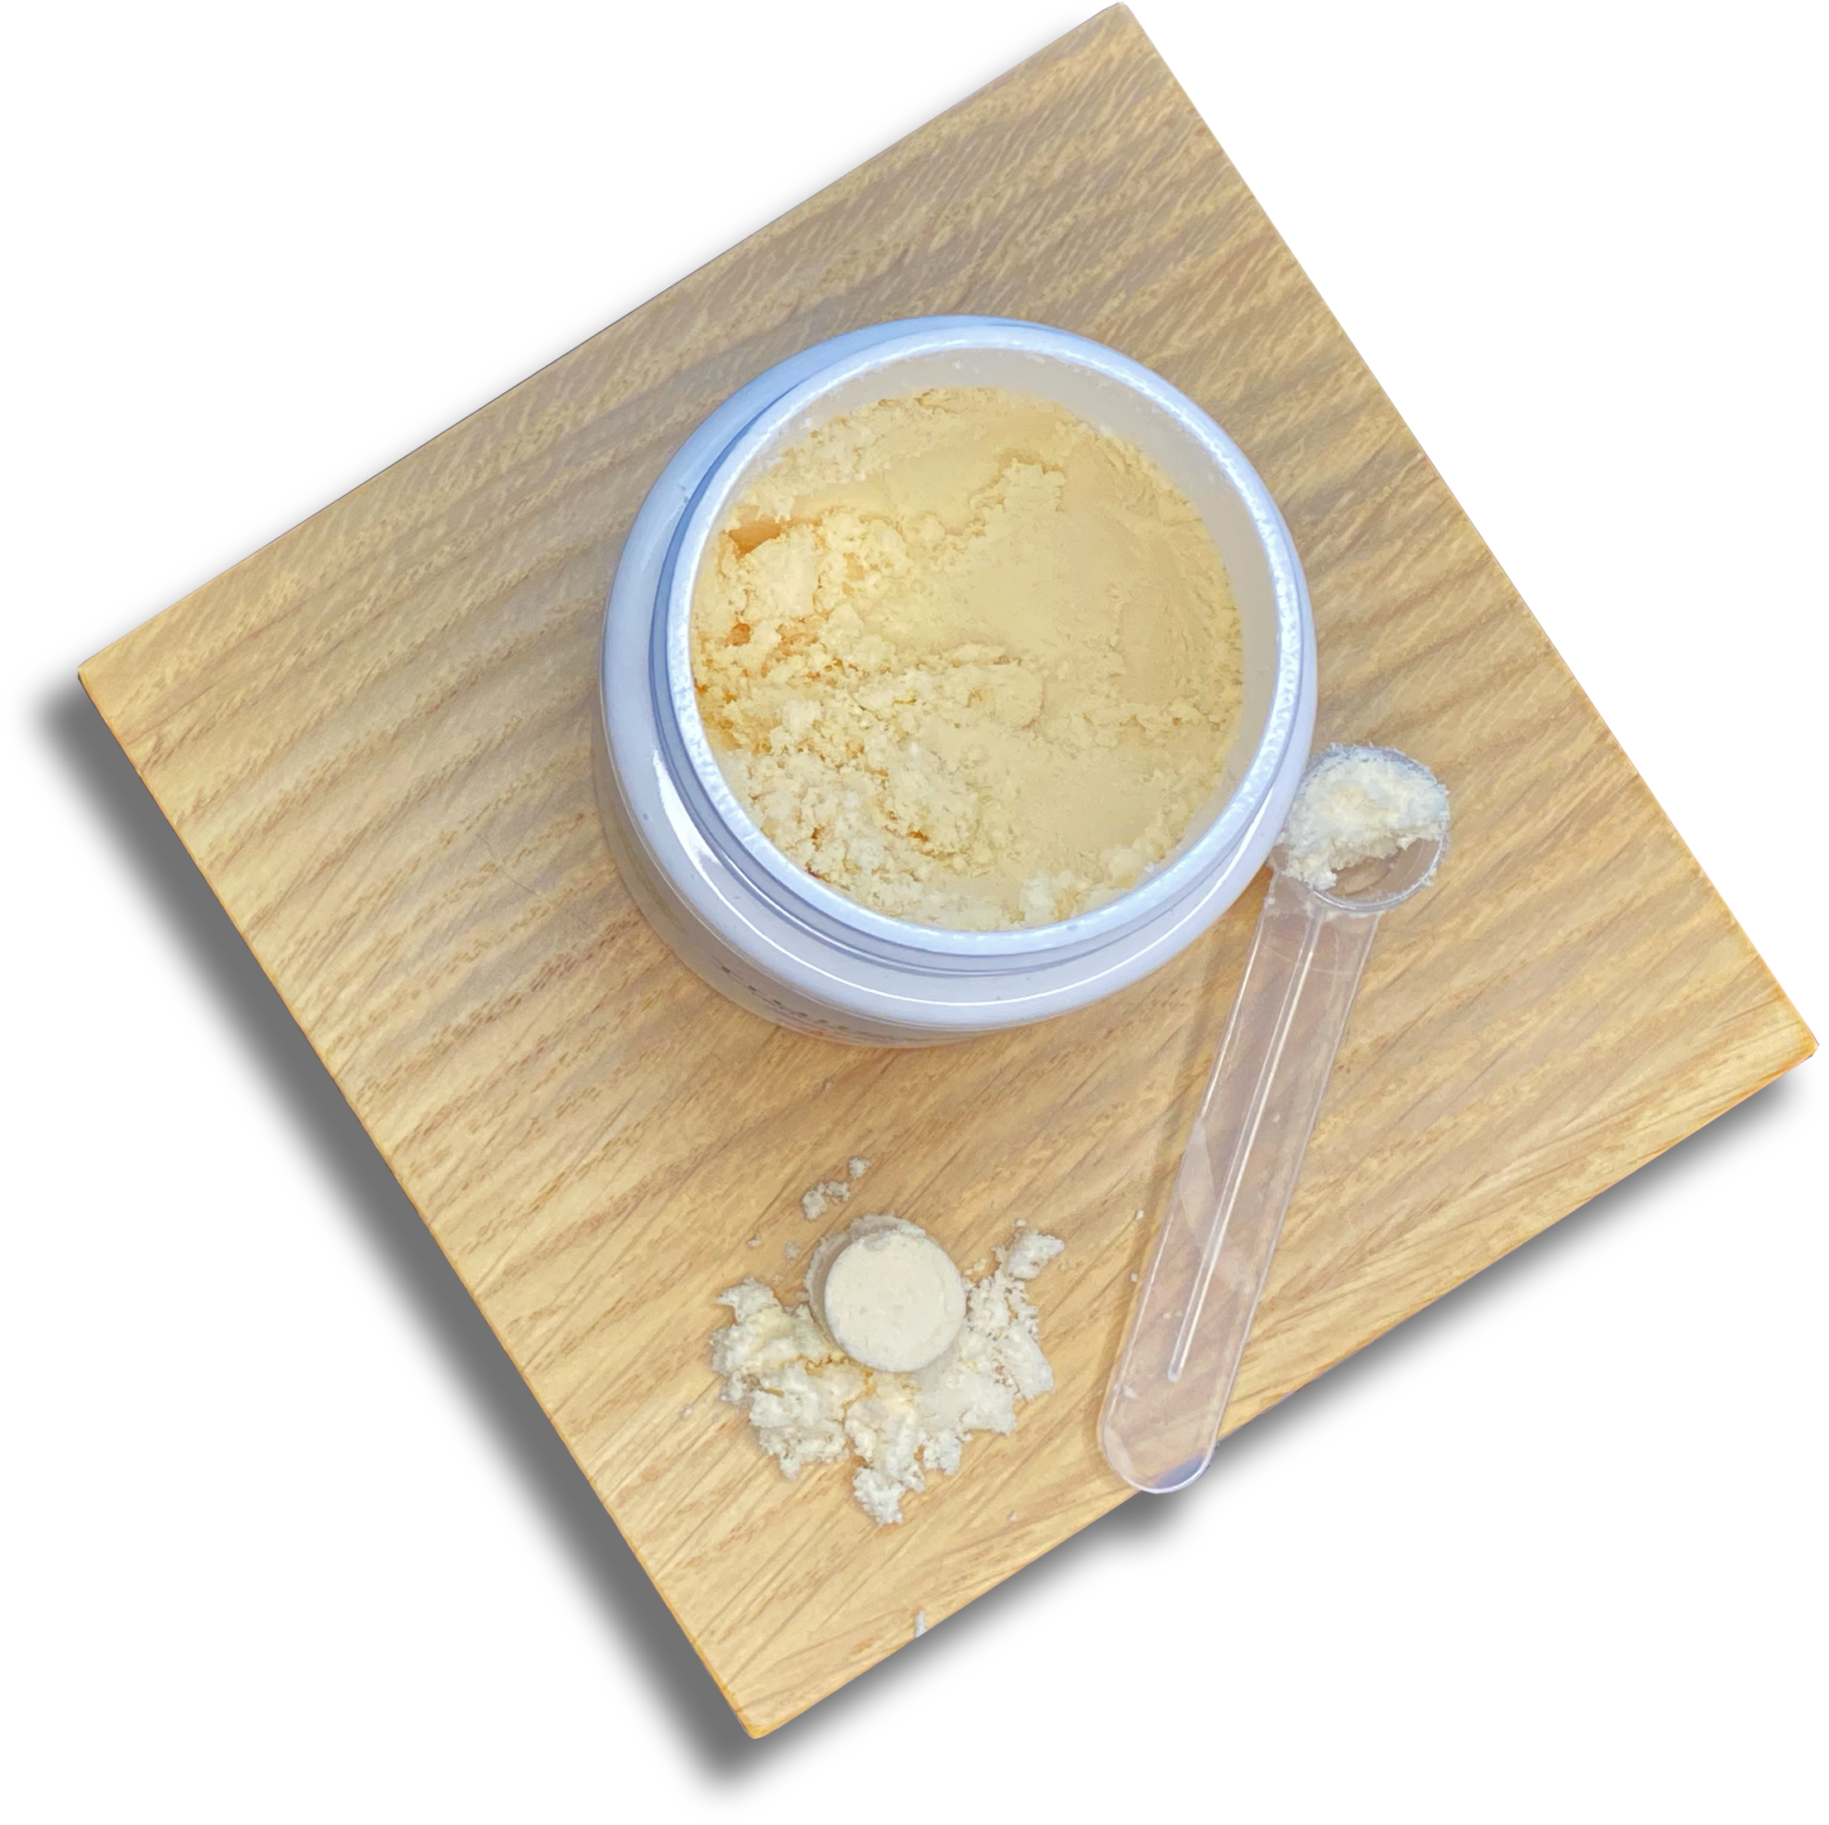
Routes of Administration Cont’d
Sublingual
  Rapid onset
  Reduce first pass metabolism
  Increased bioavailability
Nano emulsions
  Particle size less than 200NM
  Formulated to increase oral bioavailability
  Formulations to increase water solubility
  McClements D.J. Advances in edible nanoemulsions: Digestion, bioavailability, and potential toxicity. Prog. Lipid Res. 2020;81:101081. doi: 10.1016/j.plipres.2020.101081.
Notes:
Sublingual and nanotechnology are methods of improving the low bioavailability and slow onset times of oral dosing. Onset times of sublingual has been reported as quick as 15 minutes and nano emulsions allow for water soluble powder formulas to improve bioavailability.

Slide 24
Routes of Administration Cont’d
Suppository
  Small clinical study (Brenneisen et al. 1996)
    Hemisuccinate preparation
      twice the bioavailability of oral dosing
      Unstable preparation - Not commercially available
    Poor rectal absorption of unaltered cannabinoids
      Good for local conditions
Intranasal
  CBD study of rat nasal absorption model
    Absorbed 10 minutes
    Bioavailability 34-36%
Paudel KS, Hammell DC, Agu RU, Valiveti S, Stinchcomb AL. Cannabidiol bioavailability after nasal and transdermal application: effect of permeation enhancers. Drug Dev Ind Pharm. 2010 Sep;36(9):1088-97. doi: 10.3109/03639041003657295. PMID: 20545522.
Notes:
Intranasal administration is also a good option for improving onset and bioavailability. Especially for patients like children that are not candidates for inhalation but need a fast acting medicine
Suppositories are great for local conditions but have very low bioavailability unless chemically altered such as in a hemi succinate preparation that is not found commercially.
Not common

Slide 25
Metabolism
Predominantly Hepatic
  Cytochrome P450 Enzyme System, CYP 2C9, CYP 2C19, CYP 3A4
    Main THC metabolites
      11-hydroxy-THC (11-OH-THC), Psychoactive
      11-carboxy-THC (11-COOH-THC), Inactive
  High first pass metabolism of THC in Oral dosing
    Rapid THC clearance rates likely account for low bioavailability with oral doses
    Much higher concentration of 11-OH-THC after oral administration compared to inhalation
  Elimination
    Large half life variability
    Difficult to quantify due to secondary compartmentalization in lipid tissue
CBD metabolic patterns are similar to THC
  Drug Interactions
    Clobazam
See Grotenhermen et al. 2003 review for pharmacokinetic references
Notes:
CBD drug interactions Clobazam

Slide 26
THC Dosing Strategies
Slow THC Titration
Oral Dosing
  2.5 mg in evening for 1-2 days
    1.25mg or less for sensitive or low tolerance patients
  If needed and previous dose was tolerated, Increase dose by 1.25-2.5mg for 1-2 days
  Continue to increase dose by 1.25 – 2.5 mg every two days until desired effects are achieved.
    Reduce dose to best tolerated in the event of adverse effects
  Most patients dose 2-3 times a day
    Doses exceeding 20-30mg/day may increase adverse events
Inhalation Dosing
  Start with one inhalation and wait at least 15 minutes
  If needed and previous dose was tolerated, increase dose by 1 Inhalation every 15-30 minutes until desired effect is achieved
MacCallum, C.A., Russo, E.B. 2018 , Practical Considerations in Medical Cannabis Administration and Dosing. European Journal of Internal Medicine, 49: 12-19.
Notes:
Start low and go slow is the mantra for THC dosing. but here is a good regimen that was published by maccallum and Russo.

Slide 27
CBD Dosing Strategies
CBD Dosing
  Consider CBD:THC Ratio products to reduce THC psychoactive effects
    Coadministration of CBD and THC can reduce sedation intoxication and tachycardia
    (Russo et al. 2006)
  Well tolerated therapeutic dosing of purified CBD has been demonstrated between 10-20mg/kg/day for seizure disorders (Devinsky et al. 2016)
  Whole plant CBD formulations have demonstrated efficacy at lower doses
    6mg/kg/day with whole plant versus 25mg/kg/day with purified CBD extracts
    (Pamplona et al. 2018)
  Consider beginning doses of 10- 25 mg CBD
  Consider titration strategy of 1mg/kg/day, increasing every few days, for those requiring larger doses

Slide 28
Dosing Strategies Cont’d
Consider Biphasic Effects
  Lower doses can be more effective
Consider different chemotype profiles
  THCA & CBDA
  CBG, CBC, CBN
  Various Terpenoid Profiles
Encourage Patients to keep journals and share with physicians

Slide 29
References
    Boehnke KF, Scott JR, Litinas E, Sisley S, Clauw DJ, Goesling J, Williams DA. Cannabis Use Preferences and Decision-making Among a Cross-sectional Cohort of Medical Cannabis Patients with Chronic Pain. J Pain. 2019 Nov;20(11):1362-1372. doi: 10.1016/j.jpain.2019.05.009. Epub 2019 May 24. PMID: 31132510
    McPartland JM. Cannabis Systematics at the Levels of Family, Genus, and Species. Cannabis and Cannabinoid Research 2018, 3.1 http://online.liebertpub.com/doi/10.1089/can.2018.0039
    Procaccia S, Lewitus GM, Lipson Feder C, Shapira A, Berman P and Meiri D (2022) Cannabis for Medical Use: Versatile Plant Rather Than a Single Drug. Front. Pharmacol. 13:894960. doi: 10.3389/ fphar.2022.894960
    Howlett AC, Abood ME. CB₁ and CB₂ Receptor Pharmacology. Adv Pharmacol. 2017;80:169-206. doi:10.1016/bs.apha.2017.03.007
    Izzo AA, Borrelli F, Capasso R, DiMarzo V, Mechoulam R. 2009. Non-psychotropic plant cannabinoids: new therapeutic opportunities from an ancient herb. Trends Pharmacol Sci
    National Academies of Sciences, Engineering, and Medicine. 2017. The health effects of cannabis and cannabinoids: Current state of evidence and recommendations for research. Washington DC: The National Academies Press.
    Hammond D, Goodman S (2020) Knowledge of tetrahydrocannabinol and cannabidiol levels among cannabis consumers in the United States and Canada, Cannabis and Cannabinoid Research X:X, 1–10, DOI: 10.1089/can.2020.0092.
    Hammond D, Goodman S, Leos-Toro C, Wadsworth E, Reid JL, Hall W, Pacula R, Driezen P, George T, Rehm J, Werb D, Boudreau C, Porath A, Abramovich H, Elliot R. International Cannabis Policy Study Wave 1 Survey (2018). August 2018
    Angela K. Birnbaum, Ashwin Karanam, Susan E. Marino, Christopher M. Barkley, Rory P. Remmel, Michaela Roslawski, Mary Gramling-Aden, Ilo E. Leppik. Food effect on pharmacokinetics of cannabidiol oral capsules in adult patients with refractory epilepsy. Epilepsia, 2019; 60 (8): 1586 DOI: 10.1111/epi.16093

Slide 30
References Cont’d
    Grotenhermen, F. Pharmacokinetics and pharmacodynamics of cannabinoids. Clin. Pharmacokinetics. 2003, 42, 327–360.
    McClements D.J. Advances in edible nanoemulsions: Digestion, bioavailability, and potential toxicity. Prog. Lipid Res. 2020;81:101081. doi: 10.1016/j.plipres.2020.101081.
    Brenneisen R, Egli A, ElSohly MA, Henn V, Spiess Y. Int. J. Clin. Pharmacol. Ther 1996;34:446.
    Paudel KS, Hammell DC, Agu RU, Valiveti S, Stinchcomb AL. Cannabidiol bioavailability after nasal and transdermal application: effect of permeation enhancers. Drug Dev Ind Pharm. 2010 Sep;36(9):1088-97. doi: 10.3109/03639041003657295. PMID: 20545522.
    MacCallum, C.A., Russo, E.B. 2018 , Practical Considerations in Medical Cannabis Administration and Dosing. European Journal of Internal Medicine, 49: 12-19.
    Russo EB, Guy GW. A tale of two cannabinoids: the therapeutic rationale for combining tetrahydrocannabinol and cannabidiol. Med Hypotheses. 2006;66:234–246.
    Devinsky O, Marsh E, Friedman D, Thiele E, Laux L, Sullivan J, et al.. Cannabidiol in patients with treatment-resistant epilepsy: an open-label interventional trial. Lancet Neurol. (2016) 15:270–8. 10.1016/S1474-4422(15)00379-8
    Pamplona F. A., da Silva L. R., Coan A. C. (2018). Potential clinical benefits of CBD-rich Cannabis extracts over purified CBD in treatment-resistant epilepsy: observational data meta-analysis. Front. Neurol. 9:759.

Slide 31
Medical Cannabis
Dr. William Troutt N.D.
Trulieve Lead Medical Director

