Slide 1

Presented by
Wisler Saint-Vil, MD
Medical Director
MMH Sports Medicine Department
Date: 11/13/2022
Tendinopathy management with Percutaneous Needle Tenotomy and outcomes

Slide 2
Disclosure
Logo
Neither I, Wisler Saint-Vil, nor any family member(s), have any relevant financial relationships to be discussed, directly or indirectly, referred to or illustrated with or without recognition within the presentation.

Slide 3

Lecture objectives
Clinicians will
Be able to differentiate between classifications of tendon injuries
Recognize the true pathology of tendinosis and its treatment course
Determine when to consider percutaneous needle tenotomy as a treatment option for tendinosis
Understand tenotomy technique as a treatment option for tendinosis and its outcomes
Logo

Slide 4

Epidemiology
Tendinopathy is a common overuse injury in the athletic and working populations; it is the main reason for consultation for a musculoskeletal complaint and corresponds to around 30% of all such consultations with a general practitioner.
Logo
Notes:
Kaux JF, Forthomme B, Goff CL, Crielaard JM, Croisier JL. Current opinions on tendinopathy. J Sports Sci Med. 2011;10(2):238-253. Published 2011 Jun 1. https://www.ncbi.nlm.nih.gov/pmc/articles/PMC3761855/

Slide 5

Logo
Statistic - Tendinopathy
United States of America
European countries
Notes:
Tendinopathy incidence in the United States has shown an increasing trend. As per the estimates, the United States accounted for 11,920,169 incident cases in 2020 and is estimated to increase in 2030.
Among the European countries, France had the highest incident population of Tendinopathy with 4,450,554 cases, followed by the UK and Italy, in 2020.
7 MM : seven major markets i.e. US, EU5 countries (Germany, Spain, Italy, France, and the UK), and Japan
Https://www.businesswire.com/news/home/20211125005965/en/Global-Tendinopathy-Market-to-2030---Insights-Epidemiology-and-Forecasts---ResearchAndMarkets.com

Slide 6

Tendinopathy
Logo
Tendinopathy is characterized by pain in the tendon and impaired performance, sometimes associated with swelling of the tendon.
Tendinopathy Diagnosis
Tendinopathy Prevalence
Notes:
Its diagnosis is usually clinical, but ultrasonography and magnetic resonance imaging can refine the diagnosis.
Tendinopathy is highly prevalent and is one of the most frequently self-reported musculoskeletal diseases in physical workers and sportspeople.
Current opinions on tendinopathy
Jean-François Kaux

Slide 7
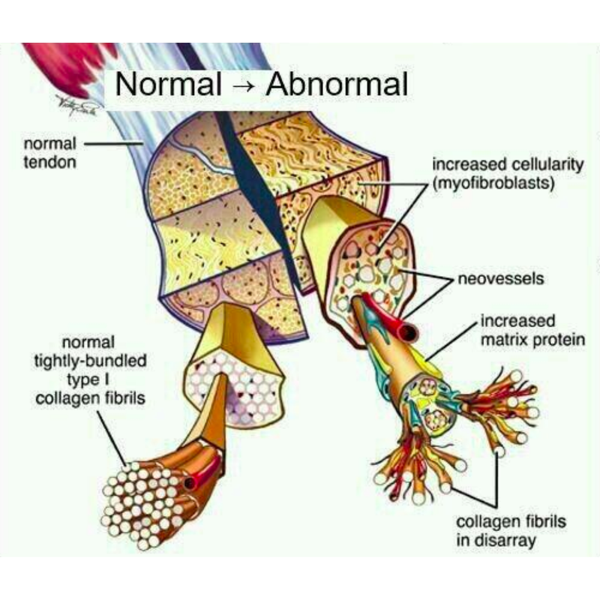
Tendon injury
Logo
Tendons attach muscle to bone and function to transfer muscle contraction to the movement of a structure such as an extremity.
Tendon injury
Tendinosis
Notes:
Tendon injury is usually due to internal tensile overload, either from acute or chronic repetitive events. This results in loss of tendon architecture, abnormal tenocyte morphology, altered collagen fibril distribution, neovascularization, and microtears.
With advancing age and overuse, alterations in tendons predominantly take the form of mucoid degeneration, termed tendinosis.
Ultrasound-Guided Percutaneous Tenotomy
Jon A. Jacobson

Slide 8
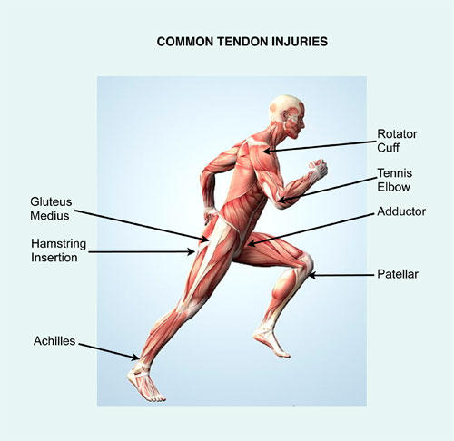
Tendon Injury
Logo
The injuries occur in almost all parts of the body, but the most affected areas are:
  Knee
  Hip
  Shoulder
  Elbow
  Thumb
  Wrist
  Achilles tendon
Sports injuries like swimmer’s shoulders, Tennis Elbow, and jumper’s knee are the most common forms of tendinosis or chronic tendon injuries.
Notes:
https://www.orthogencare.com/conditions-treated/orthopaedics/chronic-tendon-injuries

Slide 9

Logo
Pathology of tendinosis

Slide 10
Logo
Definitions of Tendon Pathology
The terms tendinitis, tendinopathy, and tendinosis are commonly used when discussing tendon injuries, but these terms are often misconstrued.
Tendinopathy is the most accurate clinical term for describing tendon pain and unclear duration dysfunction.
Tendinitis
Injury to the tendon that causes an inflammatory response and the presence of inflammatory cells
Tendinosis
Histopathologic term used when a tissue sample shows an absence or minimal presence of inflammatory cells; synonymous with angiofibroblastic dysplasia
Notes:
Although inflammation may be present, tendinopathy is primarily a degenerative process in which a failed healing response leads to pain and dysfunction.
https://www.aafp.org/afp/2019/0801/p147.html

Slide 11
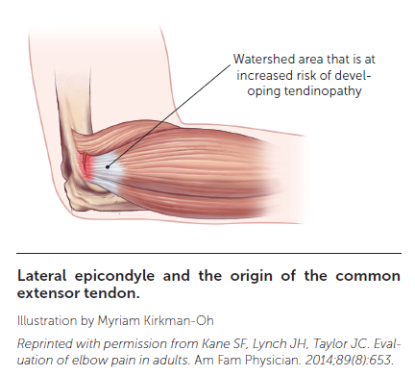
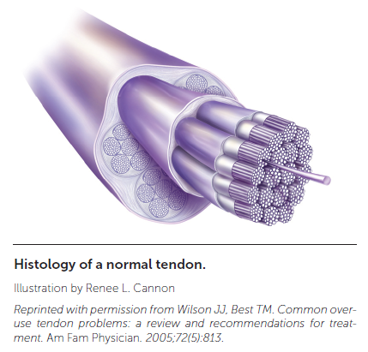
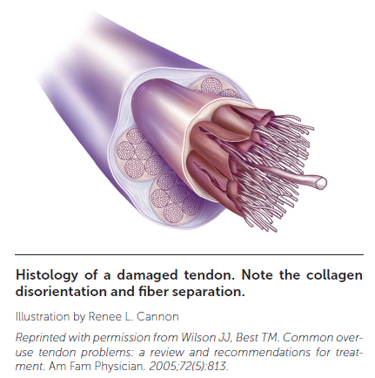
Pathophysiology
Logo
Tendon structure
    Tenocytes => Mechanoreceptive cells
    Tenoblasts
Tendon function
Tendon blood supply
    Hypovascular/watershed areas
Notes:
Tendons are biologically complex structures composed of multiple layers of tightly packed collagen fibers produced by tenocytes and tenoblasts. Tenocytes are mechanoreceptive cells that are able to change their gene expression in response to demand.
Tendons’ unique combination of strength, flexibility and elasticity allows them to carry loads and maintain tensile strength for long periods of time.
Because they have a lower oxygen consumption rate than skeletal muscle, they are also slow to heal. Tendons receive their blood supply from various sources, and pathology usually occurs in the hypovascular or watershed areas between two sources of blood supply.
https://www.aafp.org/afp/2019/0801/p147.html

Slide 12
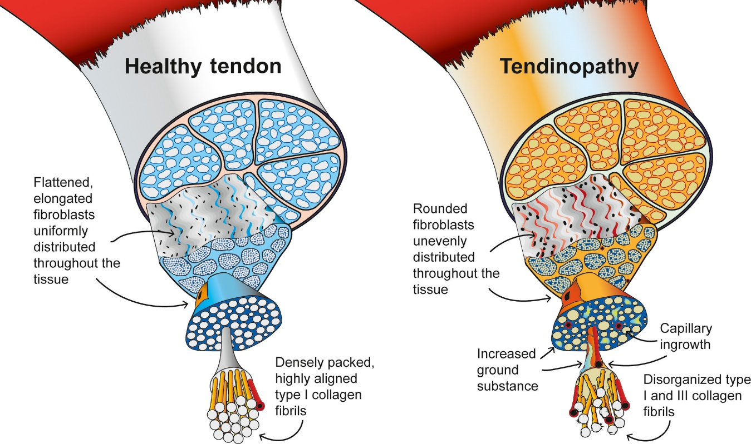
Pathophysiology
Logo
Chronic tendinopathy pain
  The etiology of chronic tendinopathy pain is unclear but has been attributed to neovascularization, neurochemicals, and mechanical breakdown.
  Presentation
  Modifiable and nonmodifiable risk factors
Tendinopathy prevention
Credit: Pathogenesis and management of tendinopathies in sports medicine
M. P. Mead,J. P. Gumucio,T. M. Awan,C. L. Mendias,K. B. Sugg, 2017
Notes:
Patients typically present with localized pain of insidious onset that is often associated with beginning a new activity or increasing the intensity of regular activities.
In addition to activity changes, other modifiable and nonmodifiable risk factors should be evaluated.
Ideally, tendinopathy can be prevented by gradually modifying activity or movement patterns. If prevention is not possible, early identification and treatment of an improper tendon response to loading activities will minimize the chance of progression to a chronic injury.
https://www.aafp.org/afp/2019/0801/p147.html

Slide 13
Logo
Etiology of tendinopathy
The etiology of tendinopathy seems to be a multifactorial process involving promoting factors that are intrinsic or extrinsic, working either alone or in combination.
Innate general factors
Age (> 40 years)
Acquired general factors
Nutrition (excess protein)
Male gender
Anatomic variants
Genetic factors
Excessive force
Body composition
High body weight
Running surface
Drugs
Joint Weakness
New physical activities
Decrease in local vascular
Repetitive loading
Excessive loading
Impingement
Notes:
Kaux JF, Forthomme B, Goff CL, Crielaard JM, Croisier JL. Current opinions on tendinopathy. J Sports Sci Med. 2011;10(2):238-253. Published 2011 Jun 1. https://www.ncbi.nlm.nih.gov/pmc/articles/PMC3761855/

Slide 14

Logo
Classifications of tendon injuries

Slide 15
Logo
Classification of tendinopathy
Tendon injuries can be classified in three ways: (1) anatomical site, (2) histopathological features, and (3) clinical profile.
Anatomical site: Lesions may occur at
  The myotendinous junction
  The osteotendinous (tendoperiosteal) junction (insertional tendinopathies)
  The tendon belly.
The most common clinical conditions referred as insertional tendinopathies are:
  Epicondylitis (lateral and medial)
  Patellar tendinitis "jumper's knee.”
  Achilles tendinitis
  Rotator cuff tendinopathy.
Notes:
Selvanetti A. Et.al. Overuse tendon injuries: Basic science and classification. Operative Techniques in Sports Medicine, Vol 5, No 3 (July), 1997: pp 110-117. https://doi.org/10.1016/S1060-1872(97)80031-7. https://www.sciencedirect.com/science/article/abs/pii/S1060187297800317

Slide 16
Logo
Classification of tendinopathy
2. Histopathologic pattern. This classification of tendinopathies includes four conditions based upon the anatomical alterations of the tendon and its surrounding tissues
Classification of Tendon Injury
NEW |  | DEFINITION
Paratenonitis |  | Inflammation of only the paratenon, whether or not lined by synovium
Paratenonitis with tendinosis |  | Paratenon inflammation associated with intratendinous degeneration
Tendinosis |  | Intratendinous degeneration due to atrophy (aging, microtrauma, vascular compromise, etc)
Tendinitis |  | Symptomatic overload of the tendon with vascular disruption and inflammatory repair response
Notes:
HISTOLOGIC FINDINGS
Inflammatory cells in paratenon tissue
Same as above, with loss of tendon collagen fibbers' disorientation, scattered vascular ingrowth but no prominent intratendinous inflammation
Noninflammatory intratendinous collagen degeneration with fibbers disorientation, hypocellularity, scattered vascular ingrowth, occasional local necrosis, or calcification
Displays variable histology from inflammation with acute hemorrhage and tear, to inflammation, superimposed upon pre-existing degeneration, to calcification and tendinosis changes in chronic conditions.
Selvanetti A. Et.al. Overuse tendon injuries: Basic science and classification. Operative Techniques in Sports Medicine, Vol 5, No 3 (July), 1997: pp 110-117. https://doi.org/10.1016/S1060-1872(97)80031-7. https://www.sciencedirect.com/science/article/abs/pii/S1060187297800317

Slide 17
Classification of tendinopathy
Logo
Functional performance. In this type of classification, pain and level of sports performance are used as indexes of the severity of the injury.
Classification of Pain Disorders Based on Symptoms and Functionality
Intensity | Level | Symptomatology | Sports Performance
Mild | 1 | No pain | Normal
 | 2 | Pain only with extreme exertion. Disappears immediately when activity stops. | Normal
Moderate | 3 | Pain starting with exertion and lasting 1-2 h afterward | Normal or slightly decreased
 | 4 | Pain increasing during any athletic activity and lasting 4-6 h afterward | Significantly decreased
Severe | 5 | Pain immediately upon any activity, forcing termination and lasting 12 to 24 hrs afterward | Markedly curtailed or prevented
 | 6 | Pain during daily activities | Unable to participate
Notes:
Selvanetti A. Et.al. Overuse tendon injuries: Basic science and classification. Operative Techniques in Sports Medicine, Vol 5, No 3 (July), 1997: pp 110-117. https://doi.org/10.1016/S1060-1872(97)80031-7. https://www.sciencedirect.com/science/article/abs/pii/S1060187297800317

Slide 18
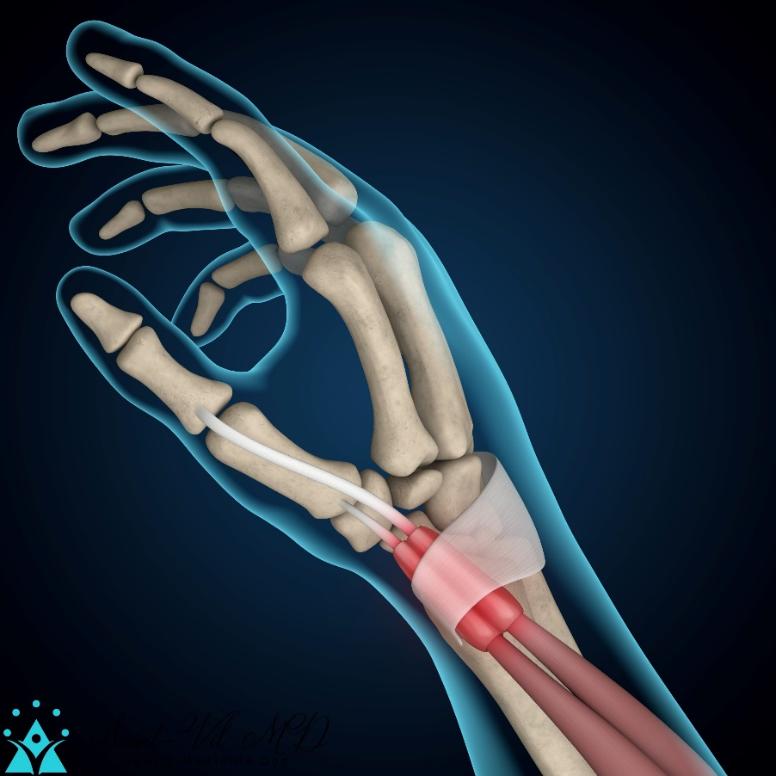
Differential diagnosis
Generally, the reason a patient seeks medical treatment is due to pain or functional limitations. The diagnosis of tendinopathy is primarily clinical.
Differential diagnosis of tendinopathy depending on localization (except for traumatic, tumoral and infectious diseases)
Localization |  | Differential diagnosis
- Wrist and hand |  | - De Quervain’s disease - intersection syndrome - carpal tunnel syndrome - radial styloiditis - Guyon’s canal syndrome - Wartenberg’s syndrome
- Elbow |  | - Common extensor tendinopathy (tennis elbow) - Common flexor tendinopathy (golf elbow) - C5-C6 radiculopathy (lateral) - C8-T1 radiculopathy (medial) - posterior interosseous nerve compression - radiocapitellar osteoarthritis/chondromalacia - osteochondritis dissecans capitellum - rheumatic enthesopathy
Notes:
Kaux JF, Forthomme B, Goff CL, Crielaard JM, Croisier JL. Current opinions on tendinopathy. J Sports Sci Med. 2011;10(2):238-253. Published 2011 Jun 1. https://www.ncbi.nlm.nih.gov/pmc/articles/PMC3761855/

Slide 19
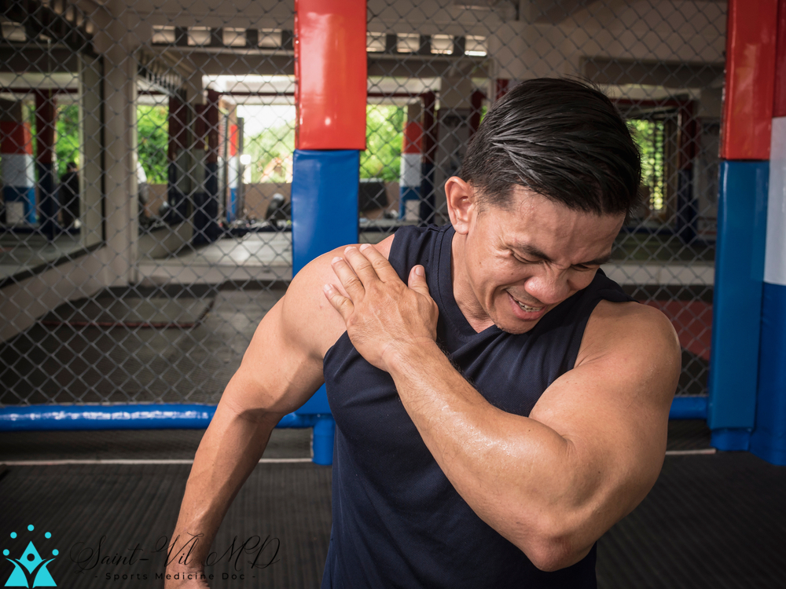
Differential diagnosis
Generally, the reason a patient seeks medical treatment is due to pain or functional limitations. The diagnosis of tendinopathy is primarily clinical.
Differential diagnosis of tendinopathy depending on localization (except for traumatic, tumoral and infectious diseases)
Localization |  | Differential diagnosis
- Shoulder |  | - rotator cuff tendinopathy - bicipital tendinopathy - frozen shoulder - acromio-clavicular pathology - instability of the shoulder - labrum / SLAP lesions - C4-C5-C6 radiculopathy
- Hip |  | - gluteus medius tendinopathy - gluteus minimus tendinopathy - greater trochanteric bursitis - ilio-tibial band tenderness - hip osteonecrosis - labral lesion - stress fracture of the femur or pelvis - femoroacetabular impingement
Notes:
Kaux JF, Forthomme B, Goff CL, Crielaard JM, Croisier JL. Current opinions on tendinopathy. J Sports Sci Med. 2011;10(2):238-253. Published 2011 Jun 1. https://www.ncbi.nlm.nih.gov/pmc/articles/PMC3761855/

Slide 20
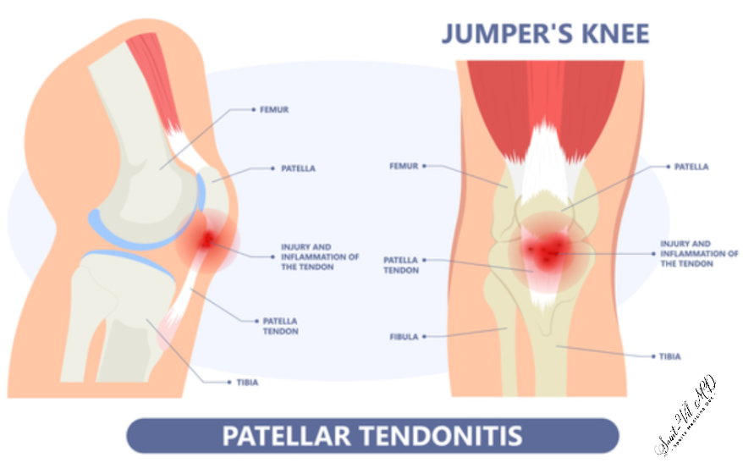
Differential diagnosis
Differential diagnosis of tendinopathy depending on localization (except for traumatic, tumoral and infectious diseases)
Localization |  | Differential diagnosis
- Knee |  | - patellar tendinopathy - quadriceps tendinopathy - hamstring tendinopathy - IT band tendinopathy - patellofemoral pain syndrome - prepatellar bursitis - Osgood-Schlatter disease - Sinding-Larsen-Johansson Disease - meniscal lesion - plica - Hoffa’s inflammation - stress fracture of the tibia or fibula
- Ankle |  | - Achilles tendinopathy - Ligament injuries - Anterior or posterior impingement - gout - retrocalcaneal bursitis - rheumatoid arthritis - Sever's Disease - stress fracture of the calcaneus
Notes:
Kaux JF, Forthomme B, Goff CL, Crielaard JM, Croisier JL. Current opinions on tendinopathy. J Sports Sci Med. 2011;10(2):238-253. Published 2011 Jun 1. https://www.ncbi.nlm.nih.gov/pmc/articles/PMC3761855/

Slide 21
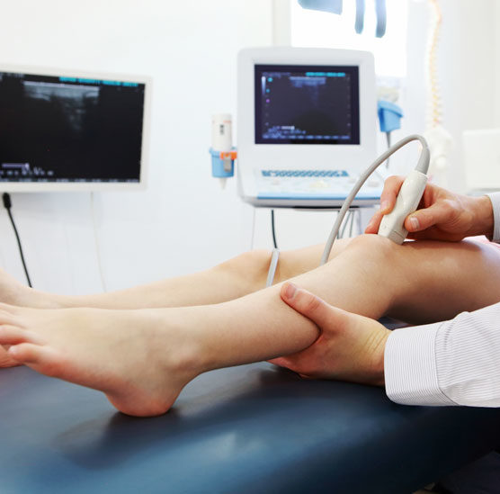
Diagnosis
Presentation
  Gradual onset of stiffness
  Activity-related pain
  Decreased function
  Localized swelling
  Palpable crepitations
Clinical examination
Diagnostic imaging
Notes:
Tendinopathies are clinically characterized by a gradual onset of stiffness in the tendon, activity-related pain, decreased function, and sometimes localized swelling and palpable crepitations.
Usually, clinical examination reveals pain with the following 3 tests: stretching, isometric contractions and palpation of the pathological area.
Although usually not required, diagnostic imaging may assist in diagnosing tendinopathy and choosing an appropriate treatment regimen.
Kaux JF, Forthomme B, Goff CL, Crielaard JM, Croisier JL. Current opinions on tendinopathy. J Sports Sci Med. 2011;10(2):238-253. Published 2011 Jun 1. https://www.ncbi.nlm.nih.gov/pmc/articles/PMC3761855/

Slide 22
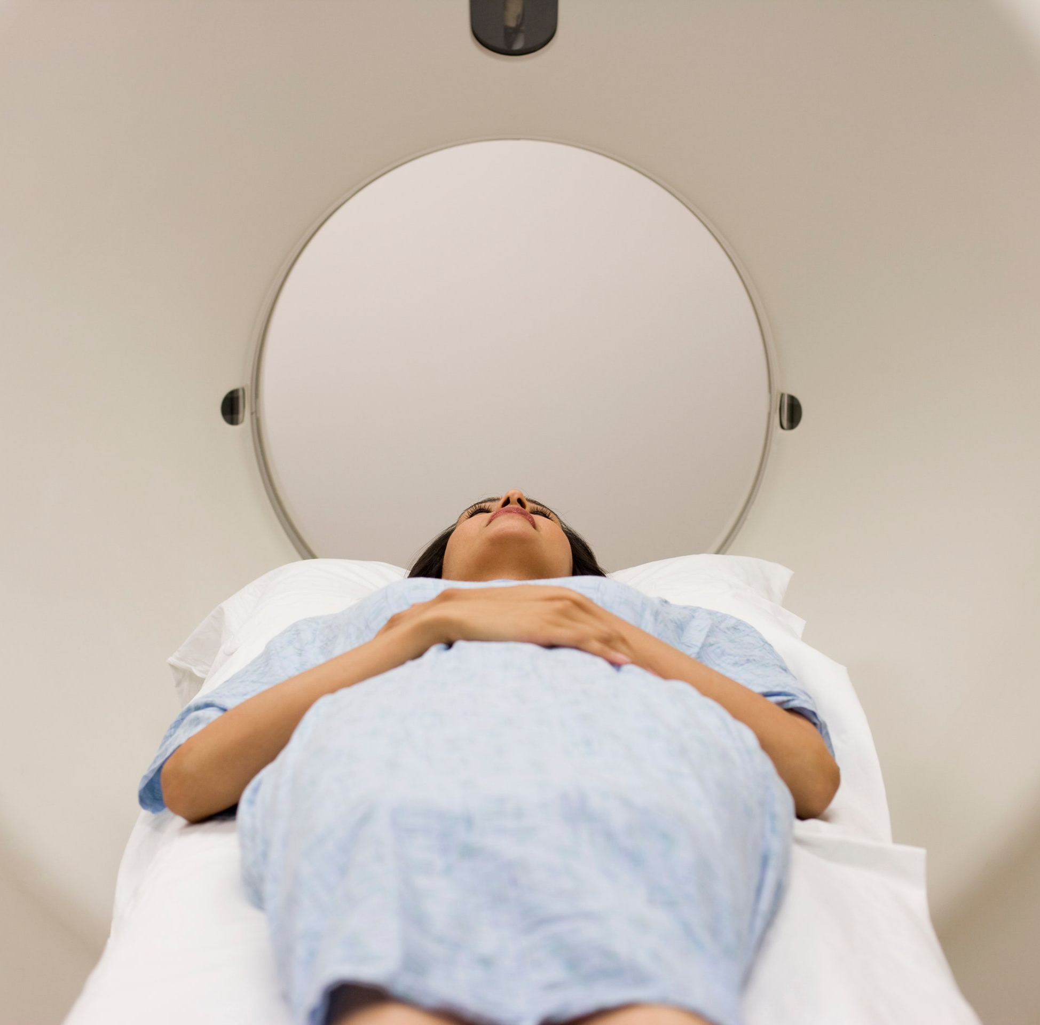
Diagnosis
Several imaging modalities can be used to evaluate tendinopathy. For instance, US and MRI are considered superior to conventional radiography or CT scanners.
Clinical assessment remains the cornerstone of appropriate diagnosis and management of tendinopathy. US and/or MRI could be useful for confirming the diagnosis, but these are not recommended for monitoring treatment.
Notes:
Several imaging modalities can be used to evaluate tendinopathy. For instance, US (with color Doppler) and MRI are considered superior to conventional radiography or CT scanners; they are usually prescribed when tendinopathy is unresponsive to treatment and entails lingering symptoms.
Clinical assessment remains the cornerstone of appropriate diagnosis and management of tendinopathy. US and/or MRI could be useful for confirming the diagnosis, but these are not recommended for monitoring treatment.
Kaux JF, Forthomme B, Goff CL, Crielaard JM, Croisier JL. Current opinions on tendinopathy. J Sports Sci Med. 2011;10(2):238-253. Published 2011 Jun 1. https://www.ncbi.nlm.nih.gov/pmc/articles/PMC3761855/

Slide 23
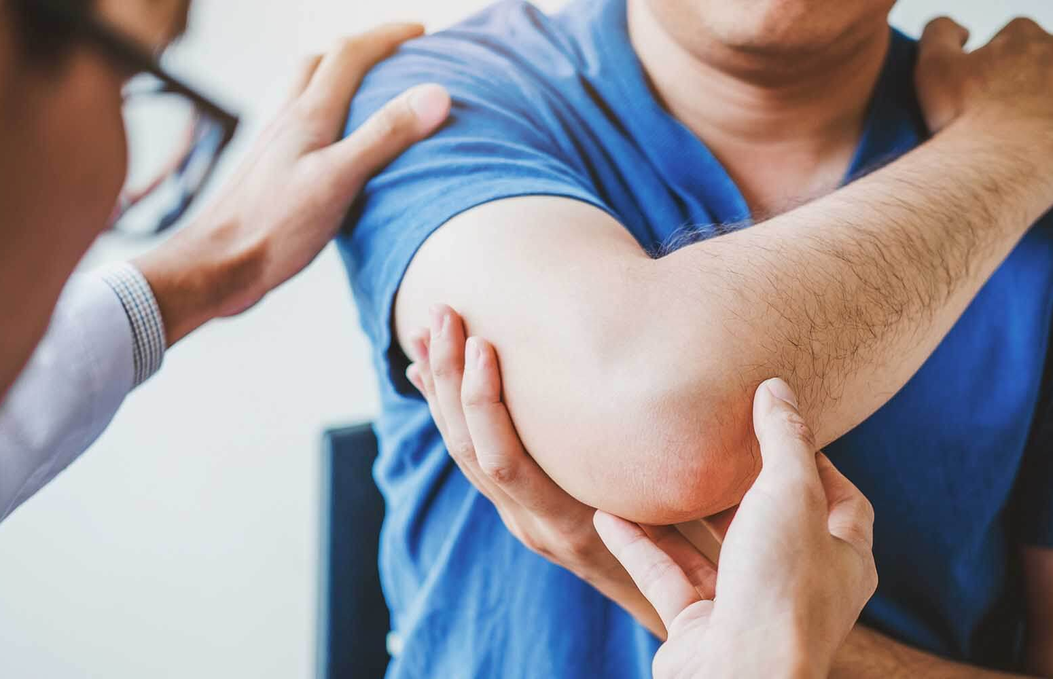
Treatment course

Slide 24

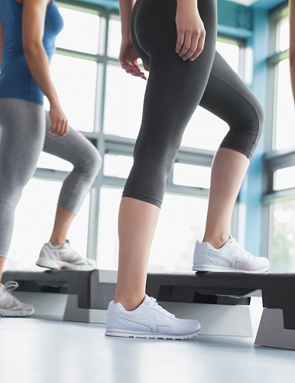

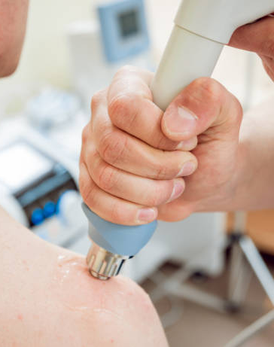

Treatment
Logo
The mainstays of initial treatment for tendinopathy are activity modification, relative rest, pain control, rehabilitative exercise, and protection.
It is essential for the patient to understand that it may take more than six months for complete symptom resolution.
Early initiation of selective and specific rehabilitative exercises is beneficial because appropriate tendon loading is critical for healing, so relative rest— not total rest—is recommended.
Cryotherapy with ice reduces pain in chronic tendinopathy, possibly by decreasing the neovascularization process, and is widely used as a simple and low-cost remedy with few adverse effects.
Bracing, NSAIDs, extracorporeal shock-wave therapy, topical vasodilators, corticosteroids injection, and PRP (platelet-rich plasma) injection can also be used to treat tendinopathies.
Notes:
Kane SF, Olewinski LH, Tamminga KS. Management of Chronic Tendon Injuries. Am Fam Physician. 2019 Aug 1;100(3):147-157. PMID: 31361101 https://www.aafp.org/afp/2019/0801/p147.html

Slide 25
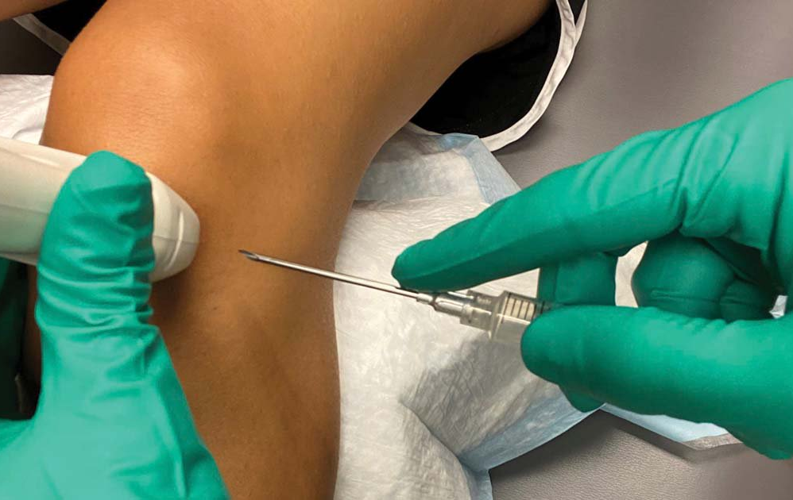
When to consider percutaneous needle tenotomy as a treatment option

Slide 26
Logo
When to consider percutaneous needle tenotomy as a treatment option
Tendinopathy has historically been treated with a wide range of interventions, including rest; cryotherapy; therapeutic ultrasound (US); stretching; strengthening; taping; bracing; NSAIDs; extracorporeal shock-wave therapy; topical vasodilators; and corticosteroid injections.
Few of these treatments have been shown to be effective, and corticosteroid injections, once a mainstay of tendinopathy treatment, have been found to be harmful to tendons. Consequently, clinicians have sought safer and more effective interventions for the treatment of this condition.
As the diagnostic capability of musculoskeletal US has improved, clinicians have also developed more advanced interventional procedures facilitated by US guidance like orthobiologic interventions, and percutaneous needle tenotomy (PNT).
Notes:
Peck E, Jelsing E, Onishi K. Advanced Ultrasound-Guided Interventions for Tendinopathy. Phys Med Rehabil Clin N Am. 2016 Aug;27(3):733-48. doi: 10.1016/j.pmr.2016.04.008. PMID: 27468675. https://pubmed.ncbi.nlm.nih.gov/27468675/

Slide 27
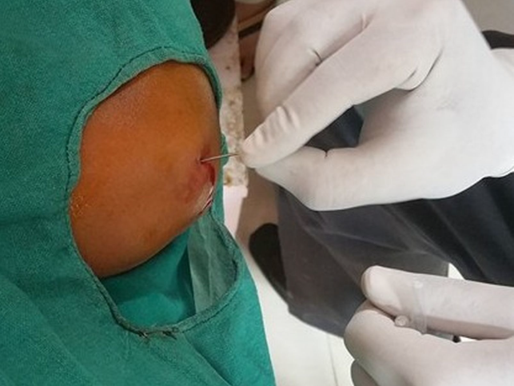
Tenotomy technique
Logo
Passing a needle into a tendon to treat tendinosis or tendon tear has been called tenotomy, fenestration, and it has been used for many tendons in the body.
The goal of the procedure is to convert a chronic degenerative process into an acute inflammatory condition that can proceed to tendon healing.
A needle passing through a segment of the degenerative tendon can disrupt areas of tendinosis. Bleeding during the process increases the concentration of growth factors that can induce inflammation as the first step in tissue healing. The effectiveness of a percutaneous tenotomy depends on the needle's accurate placement within the tendon’s diseased area. Ultrasound guidance is used for this purpose.
Notes:
Jacobson JA, Kim SM, Brigido MK. Ultrasound-Guided Percutaneous Tenotomy. Semin Musculoskelet Radiol. 2016 Nov;20(5):414-421. doi: 10.1055/s-0036-1597545. Epub 2016 Dec 21. PMID: 28002863.

Slide 28
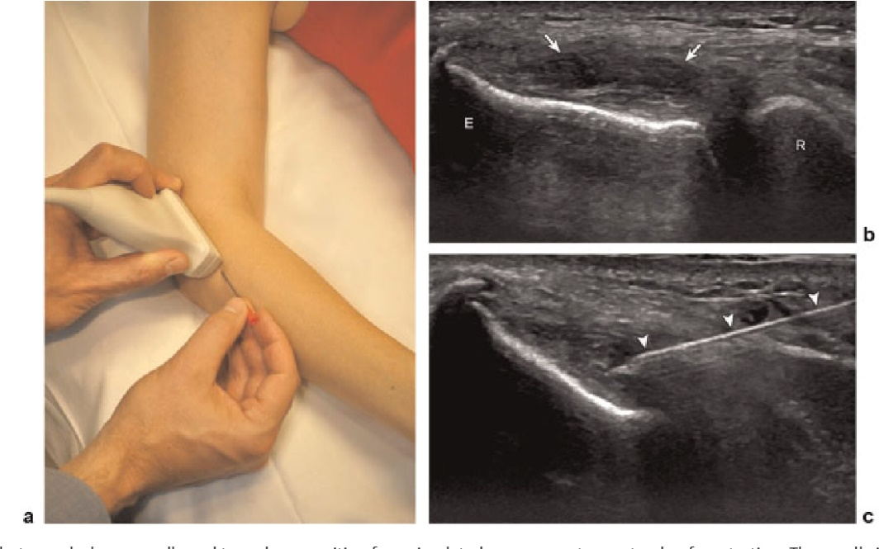
When to consider percutaneous needle tenotomy as a treatment option
Logo
The US guided percutaneous needle tenotomy is used in patients who failed to respond to conservative treatment, including
  relative rest
  pain medication
  physical therapy
  Braces
  corticosteroid injections
Credit: M. Chiavaras, J. Jacobson
Notes:
Housner JA, Jacobson JA, Misko R. Sonographically guided percutaneous needle tenotomy for the treatment of chronic tendinosis. J Ultrasound Med. 2009 Sep;28(9):1187-92. doi: 10.7863/jum.2009.28.9.1187. PMID: 19710216. https://pubmed.ncbi.nlm.nih.gov/19710216/

Slide 29
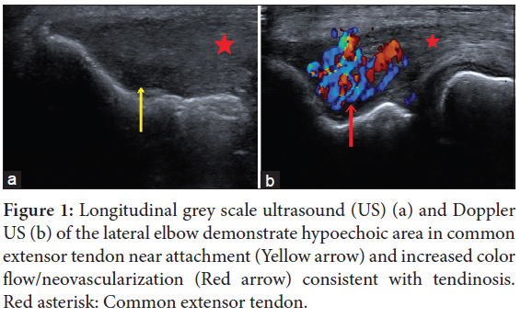
Patient selection criteria
The patient selection for US-guided PNT depends on the clinico-radiological qualitative and quantitative assessments.
The qualitative clinical assessment is the presence of pain and disability attributable to the affected tendon.
The quantitative clinical assessments are done by VAS and various disability scores for each region such as disabilities of the arm, shoulder, and hand score.
The radiological assessment is done by the US which includes the presence of intratendinous hypoechogenecity with or without a discrete tear, intratendinous and peritendinous color flow on Doppler, and the presence or absence of underlying bony changes.
The criteria of patient selection for US-guided PNT
Clinical score (VAS) | More than 5
US Imaging appearance of tendon | The hypoechoic area on the US with intratendinous and/peritendinous color flow on Doppler Absence of tendon tear
VAS : Visual analogue scale, US: Ultrasound, PNT : Percutaneous needle tenotomy
Notes:
Singh D, Nayak B, Kumar M, Tomar S, Katyan A, Suman S, et al. Ultrasound-guided percutaneous needle tenotomy for tendinosis. Indian J Musculoskelet Radiol 2020;2(1):52-7. https://mss-ijmsr.com/view-pdf/?article=155927767921b5128130f926554923661KDvgw==

Slide 30
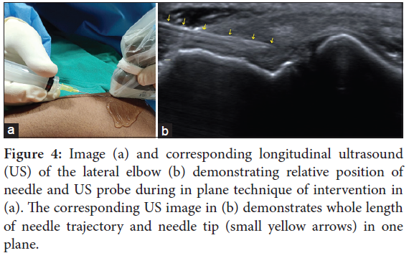
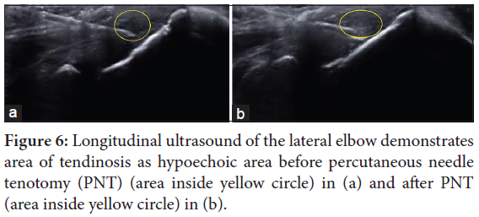
Patient selection criteria
The quantitative radiological assessments are the dimension of the hypoechoic area of tendinosis and measurement of tear if present. The quantitative clinico-radiological assessments serve as baseline values for comparative analysis on follow-up.
Notes:
Singh D, Nayak B, Kumar M, Tomar S, Katyan A, Suman S, et al. Ultrasound-guided percutaneous needle tenotomy for tendinosis. Indian J Musculoskelet Radiol 2020;2(1):52-7. https://mss-ijmsr.com/view-pdf/?article=155927767921b5128130f926554923661KDvgw==

Slide 31
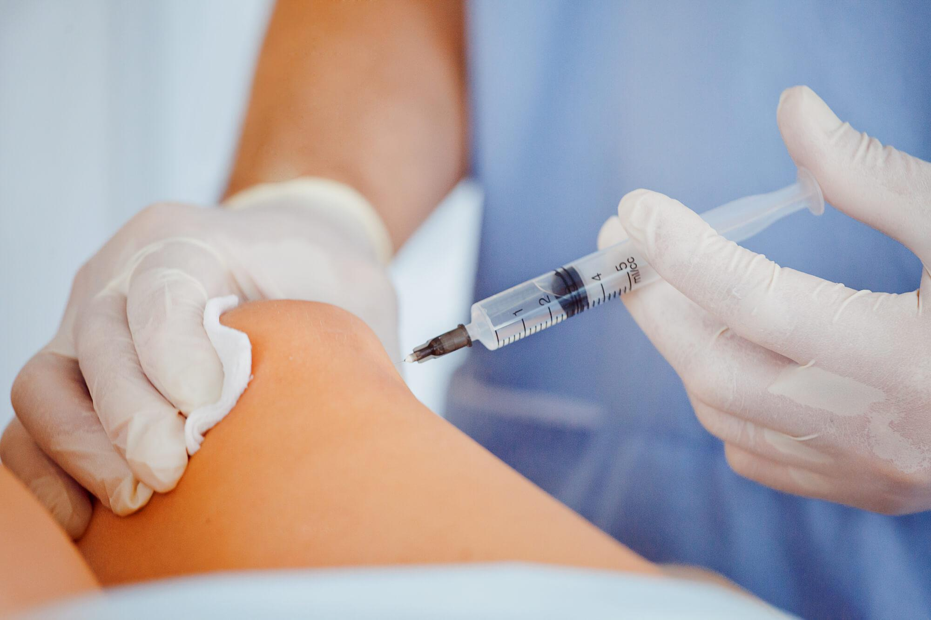
Understand tenotomy technique as a treatment option for tendinosis and its outcomes

Slide 32
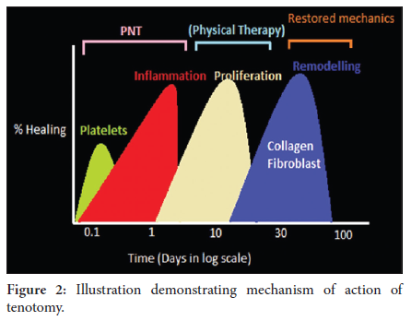
Mechanism of action of tenotomy
US-guided PNT (Ultrasound-guided percutaneous needle tenotomy) involves repeatedly passing a needle under US guidance through the targeted area of tendinosis to disrupt the degenerative process, including scar tissue, and encouraging localized bleeding, and fibroblast proliferation, which can lead to growth factor release, collagen formation, and ultimately healing.
The US-guided PNT is an accepted technique for the treatment of tendinosis within some limitations of current literature.
Notes:
Singh D, Nayak B, Kumar M, Tomar S, Katyan A, Suman S, et al. Ultrasound-guided percutaneous needle tenotomy for tendinosis. Indian J Musculoskelet Radiol 2020;2(1):52-7. https://mss-ijmsr.com/view-pdf/?article=155927767921b5128130f926554923661KDvgw==

Slide 33
Ultrasound-guided percutaneous needle tenotomy for tendinosis
Tendinosis is a degenerative condition rather than an inflammatory one. Therefore, regenerative healing treatments such as US-guided percutaneous orthobiologic treatments are showing promising results compared to anti-inflammatory treatments.
The US-guided PNT is done till the hypoechoic area of tendinosis becomes isoechoic to the normal-appearing tendon or a lack of resistance. This precise endpoint is one of the significant advantages of doing US-guided PNT compared to the blind PNT.
The outcome of US-guided PNT may be adversely affected due to the chronicity of tendinosis, associated calcification, disuse of muscle due to chronic tendinosis, overuse of antagonist’s muscle, and poor compliance with rehabilitation.
Notes:
Singh D, Nayak B, Kumar M, Tomar S, Katyan A, Suman S, et al. Ultrasound-guided percutaneous needle tenotomy for tendinosis. Indian J Musculoskelet Radiol 2020;2(1):52-7. https://mss-ijmsr.com/view-pdf/?article=155927767921b5128130f926554923661KDvgw==

Slide 34
Outcome of tenotomy technique
Objective: To report our experience with sonographically guided percutaneous needle tenotomy to relieve pain and improve function in patients with extensor tendon of the lateral elbow.
Methods: Sonographically guided percutaneous needle tenotomy was performed on 58 consecutive patients who had persistent pain and disability resulting from common extensor tendinosis. Under a local anesthetic and sonographic guidance, a needle was advanced into the common extensor tendon, and the tip of the needle was used to repeatedly fenestrate the tendinotic tissue. Calcifications, if present, were mechanically fragmented, and the adjacent bony surface of the apex and face of the epicondyle were abraded. Finally, the fenestrated tendon was infiltrated with a solution containing corticosteroid mixed with bupivacaine. After the procedure, patients were instructed to perform passive stretches and to undergo physical therapy.
Results: Fifty-five (95%) of 58 patients were contacted by telephone and agreed to participate in the study. Thirty-five (63.6%) of 55 respondents reported excellent outcomes, 16.4% good, 7.3% fair, and 12.7% poor. The average follow-up time from the date of the procedure to the date of the interview was 28 months (range, 17-44 months). No adverse events were reported; 85.5% stated that they would refer a friend or close relative for the procedure.
Conclusions: Sonographically guided percutaneous needle tenotomy for lateral elbow tendinosis is a safe, effective, and viable alternative for patients in whom all other nonsurgical treatments failed.
Notes:
McShane JM, Nazarian LN, Harwood MI. Sonographically guided percutaneous needle tenotomy for treatment of common extensor tendinosis in the elbow. J Ultrasound Med. 2006 Oct;25(10):1281-9. doi: 10.7863/jum.2006.25.10.1281. PMID: 16998100. https://pubmed.ncbi.nlm.nih.gov/16998100/

Slide 35
Outcome of tenotomy technique
Introduction: This report evaluates the efficacy of percutaneous needle puncture under sonographic guidance in treating lateral epicondylitis (tennis-elbow).
Methods: Ultrasound-guided percutaneous needle puncture was performed on 76 patients who presented with persistent elbow pain. Under a local anesthetic and sonographic guidance, a needle was advanced into the calcification foci and the calcifications were mechanically fragmented. This was followed by a local injection of 25 mg prednisone acetate and 1% lidocaine. If no calcification was found then multiple punctures were performed followed by local injection of 25 mg prednisone acetate and 1% lidocaine. A visual analog scale (VAS) was used to evaluate the degree of pain pre-and post treatment at 1 week to 24 weeks. Elbow function improvement and degree of self-satisfaction were also evaluated.
Results: Of the 76 patients, 55% were rated with excellent treatment outcome, 32% good, 11% average, and 3% poor. From 3 weeks post treatment, VAS scores were significantly reduced compared with the pre-treatment score (P<0.05) and continued to gradually decline up to 24 weeks post treatment. Sonography demonstrated that the calcified lesions disappeared completely in 13%; reduced in 61%; and did not change in 26% of the patients. Color Doppler flow signal used to assess hemodynamic changes showed a significant improvement after treatment in most patients.
Conclusion: Ultrasound-guided percutaneous needle puncture is an effective and minimally invasive treatment for tennis elbow. Sonography can be used to accurately identify the puncture location and monitor changes.
Notes:
Zhu J, Hu B, Xing C, Li J. Ultrasound-guided, minimally invasive, percutaneous needle puncture treatment for tennis elbow. Adv Ther. 2008 Oct;25(10):1031-6. doi: 10.1007/s12325-008-0099-6. PMID: 18791678. https://pubmed.ncbi.nlm.nih.gov/18791678/

Slide 36
Outcome of tenotomy technique
Objective: To determine the effectiveness of percutaneous sonographically guided needle tenotomy with various tendons throughout the body.
Methods: Fourteen tendons in 13 patients were identified as having a greater than 6-month history of clinical presentation consistent with tendinopathy that had failed treatment with physical therapy. All patients were treated with sonographically guided percutaneous tenotomy using a 22-gauge needle and a local anesthetic. A visual analog scale (VAS) pain score measurement was obtained before the procedure and at 4- and 12-week follow-up appointments. All complications were recorded.
Results: The 14 tendons in this study included patellar (5), Achilles (4), proximal gluteus medius (1), proximal iliotibial tract (1), proximal hamstring (1), common extensor elbow (1), and proximal rectus femoris (1). The composite VAS score was significantly lower at both 4 weeks (mean +/- SEM, 2.4 +/- 0.7) and 12 weeks (2.2 +/- 0.7) compared with the baseline (5.8 +/- 0.6; P < .001). No complications or morbidity occurred.
Conclusions: Sonographically guided percutaneous tenotomy of tendinosis was effective in improving patient symptoms without complications.
Notes:
Housner JA, Jacobson JA, Misko R. Sonographically guided percutaneous needle tenotomy for the treatment of chronic tendinosis. J Ultrasound Med. 2009 Sep;28(9):1187-92. doi: 10.7863/jum.2009.28.9.1187. PMID: 19710216. https://pubmed.ncbi.nlm.nih.gov/19710216/

Slide 37
Outcome of tenotomy technique
Materials and methods: This non-randomized control trial was conducted on 50 patients who underwent percutaneous release of the common extensor origin using an 18 gauge hypodermic needle. These patients did not respond to conservative treatment including rest, nonsteroidal anti-inflammatory drugs (NSAIDS) and local steroid injections.
Results: Out of fifty patients, thirty-two were female (64%), and 18 were male (36%). The right side was affected in 37 patients (74%) and left side in 13 (26%). The time taken to achieve a completely pain-free elbow ranged from one day to two months (average of 26.2 days). Those who did not achieve a pain-free elbow had a residual pain of 1.5 to six on the visual analogue scale (VAS) (average 2.32). Excellent outcome was noticed in 24 patients (48%); Good result in eight patients (36%); Fair in four patients (eight percent) and Poor in four patients (eight percent).
Conclusion: Tennis elbow probably results from the degenerative tear of the common extensor origin, and a percutaneous tenotomy using an 18 gauge hypodermic needle is a simple, safe, patient-friendly, efficient, and easily reproducible method of treating tennis elbow in those who are resistant to conservative treatment, and it can be done as an outpatient procedure.
Notes:
Panthi S, Khatri K, Kharel K, Byanjankar S, Shrestha R, Sharma JR, Vaishya R, Agarwal AK, Vijay V. Outcome of Percutaneous Release of Tennis Elbow: A Non-Randomized Controlled Trial Study. Cureus. 2017 Jan 2;9(1):e952. doi: 10.7759/cureus.952. PMID: 28168130; PMCID: PMC5289923. https://pubmed.ncbi.nlm.nih.gov/28168130/

Slide 38
Outcome of tenotomy technique
In summary, there has only been 1 prospective study of the outcomes of US-guided PNT as the sole intervention for tendinopathy. However, all of the current PNT literature consistently notes improvement in symptoms and reports rare complications. Larger, randomized controlled trials are needed. Further prospective research is also needed to determine whether PNT should be repeated when a patient experiences sub-optimal results or partial improvement and when this is indicated. In addition, future investigations should address whether patients with partial-thickness tears fare better or worse than those with tendinopathy alone when treated with PNT.
Notes:
Peck E, Jelsing E, Onishi K. Advanced Ultrasound-Guided Interventions for Tendinopathy. Phys Med Rehabil Clin N Am. 2016 Aug;27(3):733-48. doi: 10.1016/j.pmr.2016.04.008. PMID: 27468675. https://pubmed.ncbi.nlm.nih.gov/27468675/

Slide 39
Take Home Points
Tendinopathy is highly prevalent and is one of the most frequently self-reported musculoskeletal diseases in physical workers and sportspeople.
The etiology of tendinopathy seems to be a multifactorial process involving promoting factors that are intrinsic or extrinsic, working either alone or in combination.
Clinical assessment remains the cornerstone of appropriate diagnosis and management of tendinopathy. US and/or MRI could be useful for confirming the diagnosis, but these are not recommended for monitoring treatment.
The mainstays of initial treatment for tendinopathy are activity modification, relative rest, pain control, rehabilitative exercise, cryotherapy, and protection.

Slide 40
Take Home Points
The percutaneous needle tenotomy is used in patients who failed to respond to conservative treatment.
The patient selection for US-guided PNT depends on the clinico-radiological qualitative and quantitative assessments.
Tendinosis is a degenerative condition rather than an inflammatory one. Therefore, regenerative healing treatments such as US-guided percutaneous tenotomy treatments are showing great results compared to anti-inflammatory therapies.
Various PNT research consistently note improvement in symptoms and report rare complications.

Slide 41
References
Chronic Tendon Injuries. https://www.orthogencare.com/conditions-treated/orthopaedics/chronic-tendon-injuries
Global Tendinopathy Market to 2030 - Insights, Epidemiology and Forecasts - ResearchAndMarkets.com. November 25, 2021. https://www.businesswire.com/news/home/20211125005965/en/Global-Tendinopathy-Market-to-2030---Insights-Epidemiology-and-Forecasts---ResearchAndMarkets.com
Kane SF, et.al. Management of Chronic Tendon Injuries. Am Fam Physician. 2019 Aug 1;100(3):147-157. PMID: 31361101 https://www.aafp.org/afp/2019/0801/p147.html
Kaux JF, et.al. Current opinions on tendinopathy. J Sports Sci Med. 2011;10(2):238-253. Published 2011 Jun 1. https://www.ncbi.nlm.nih.gov/pmc/articles/PMC3761855/
Housner JA, et.al. Sonographically guided percutaneous needle tenotomy for the treatment of chronic tendinosis. J Ultrasound Med. 2009 Sep;28(9):1187-92. doi: 10.7863/jum.2009.28.9.1187. PMID: 19710216. https://pubmed.ncbi.nlm.nih.gov/19710216/
Jacobson JA, et.al. Ultrasound-Guided Percutaneous Tenotomy. Semin Musculoskelet Radiol. 2016 Nov;20(5):414-421. doi: 10.1055/s-0036-1597545. Epub 2016 Dec 21. PMID: 28002863.
Mattie R, et.al. Percutaneous Needle Tenotomy for the Treatment of Lateral Epicondylitis: A Systematic Review of the Literature. PM R. 2017 Jun;9(6):603-611. doi: 10.1016/j.pmrj.2016.10.012. Epub 2016 Oct 22. PMID: 27780771. https://pubmed.ncbi.nlm.nih.gov/27780771/
McShane JM, et.al. Sonographically guided percutaneous needle tenotomy for treatment of common extensor tendinosis in the elbow. J Ultrasound Med. 2006 Oct;25(10):1281-9. doi: 10.7863/jum.2006.25.10.1281. PMID: 16998100. https://pubmed.ncbi.nlm.nih.gov/16998100/

Slide 42
References
Panthi S, et.al. Outcome of Percutaneous Release of Tennis Elbow: A Non-Randomized Controlled Trial Study. Cureus. 2017 Jan 2;9(1):e952. doi: 10.7759/cureus.952. PMID: 28168130; PMCID: PMC5289923. https://pubmed.ncbi.nlm.nih.gov/28168130/
Peck E, et.al. Advanced Ultrasound-Guided Interventions for Tendinopathy. Phys Med Rehabil Clin N Am. 2016 Aug;27(3):733-48. doi: 10.1016/j.pmr.2016.04.008. PMID: 27468675. https://pubmed.ncbi.nlm.nih.gov/27468675/
Selvanetti A. et.al. Overuse tendon injuries: Basic science and classification. Operative Techniques in Sports Medicine, Vol 5, No 3 (July), 1997: pp 110-117. https://doi.org/10.1016/S1060-1872(97)80031-7. https://www.sciencedirect.com/science/article/abs/pii/S1060187297800317
Settergren R. Treatment of supraspinatus tendinopathy with ultrasound guided dry needling. J Chiropr Med. 2013 Mar;12(1):26-9. doi: 10.1016/j.jcm.2012.11.002. PMID: 23997721; PMCID: PMC3610946. https://pubmed.ncbi.nlm.nih.gov/23997721/
Singh D, et al. Ultrasound-guided percutaneous needle tenotomy for tendinosis. Indian J Musculoskelet Radiol 2020;2(1):52-7. https://mss-ijmsr.com/view-pdf/?article=155927767921b5128130f926554923661KDvgw==
Stoychev V, et.al. Dry Needling as a Treatment Modality for Tendinopathy: a Narrative Review. Curr Rev Musculoskelet Med. 2020;13(1):133-140. doi:10.1007/s12178-020-09608-0. https://www.ncbi.nlm.nih.gov/pmc/articles/PMC7083985/
Zhu J, et.al. Ultrasound-guided, minimally invasive, percutaneous needle puncture treatment for tennis elbow. Adv Ther. 2008 Oct;25(10):1031-6. doi: 10.1007/s12325-008-0099-6. PMID: 18791678. https://pubmed.ncbi.nlm.nih.gov/18791678/

Slide 43

Logo
Thank you !

